Slide 1
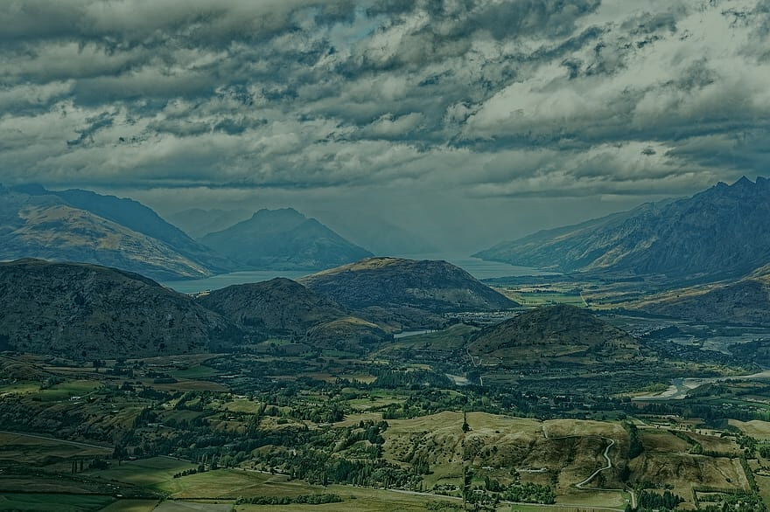
PROPOSED CHAPTER 39 WĀHI TŪPUNA
and the Queenstown Lakes District Council
Proposed District Plan

Slide 2
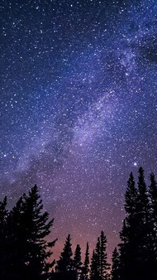
Na Te Timatanga Me Te Waiatatanga Mai o Te Atua
(The beginning of the singing of the Atua is with Te Po, 'The night')
Te Waiatatanga mai o Te Atua
Te Pō (The Night)
Te Ao (The Day)
Te Aomarama (The Bright Day)
Te Aotūroa (The Long-standing Day)
Te Koretewhiwhia (The Unattainable Void)
Te Koreterawea (The Intangible Void)
Te Koretetamaua (The Unstable Void)
Te Korematua (The Parentless)
Te Maku (The Damp), who couple with Mahoranuiatea, and Raki (The Sky) was born
Ka Puta ko Raki
Tuatahi e moe ana Raki i Pokoharua-i-te-Po
Tuarua e moe ana Papatūānuku....

Slide 3
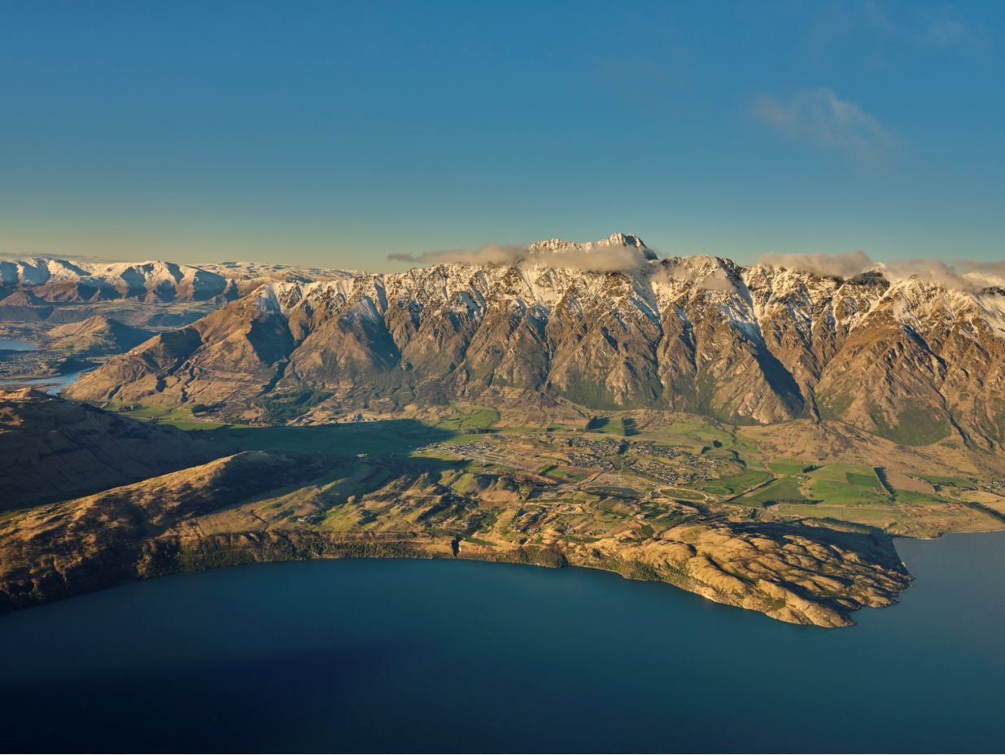
Tiramorehu
  The Tiramorehu account from the waiata tells of a beginning that was in total darkness.
  This was followed by the emergence of light into a great void of nothingness.
  In time Maku mated with Mahoranuiatea which resulted in great expanses of water.
  Then, Papatūānuku and Takaroa met and had children after which Takaroa left for a long period of time.
  A lonely Papatūānuku (Earth Mother) then met Rakinui (Sky Father), they had many children who conspired to force their parents coupled bodies apart to let the light in.

Slide 4
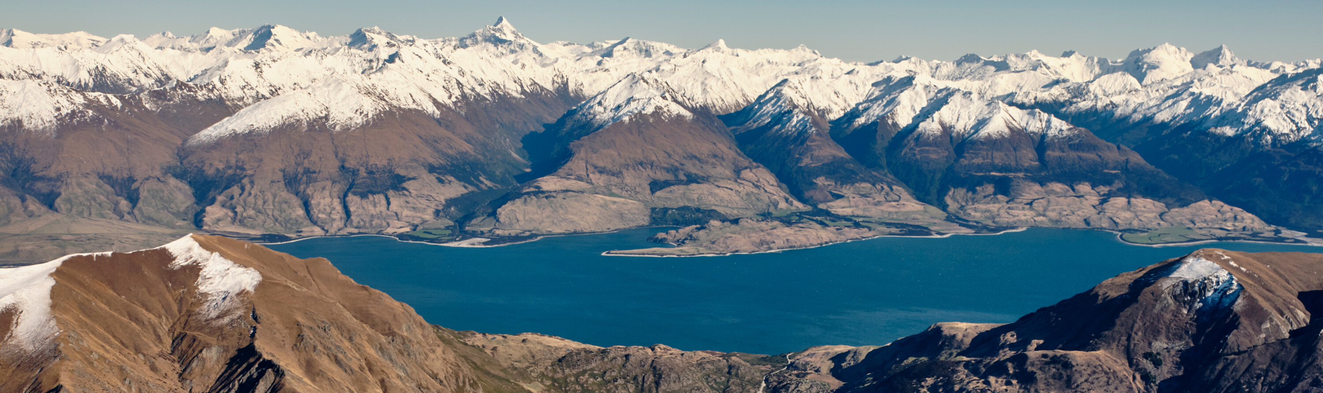
The dominant offspring who took an interest in human affairs were;
  Tāne, Tūmataueka, Rongo, Haumietiketike, Tāwhirimātea, Whiro and Rūaumoko.
  Tāne was successful in forcing the separation.
A process of creation followed that included shaping of the natural world that makes up the earthly environment, of the heavens, and ultimately the emergence of mankind.
Offspring of Rakinui and Papatūānuku

Slide 5

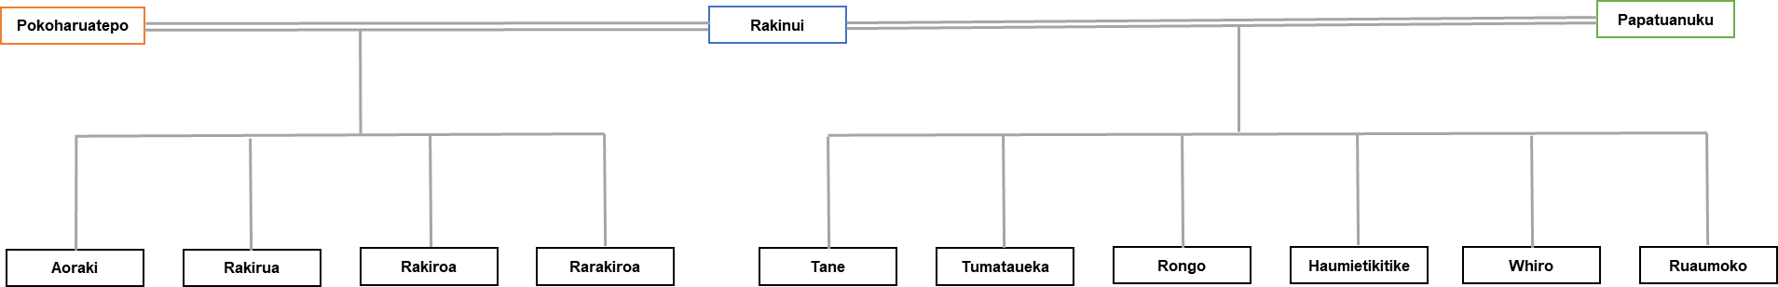
Division of Duties
Division of responsibilities among the eighty or so children of Rakinui and Papatūānuku
  Across the heavens, sky, air, land, water and flora and fauna, sea life and the underground and many more elements.
  The demi-gods or Atua include for example Tāne (birds and forests), Tāwhirimātea (weather, wind and the elements), Ruaumoko (underground and earthquakes) and so on.
Two of the wives of Rakinui:
(the dominant offspring of the union of Rakinui and Papatūānuku who took an interest in human affairs)

Slide 6
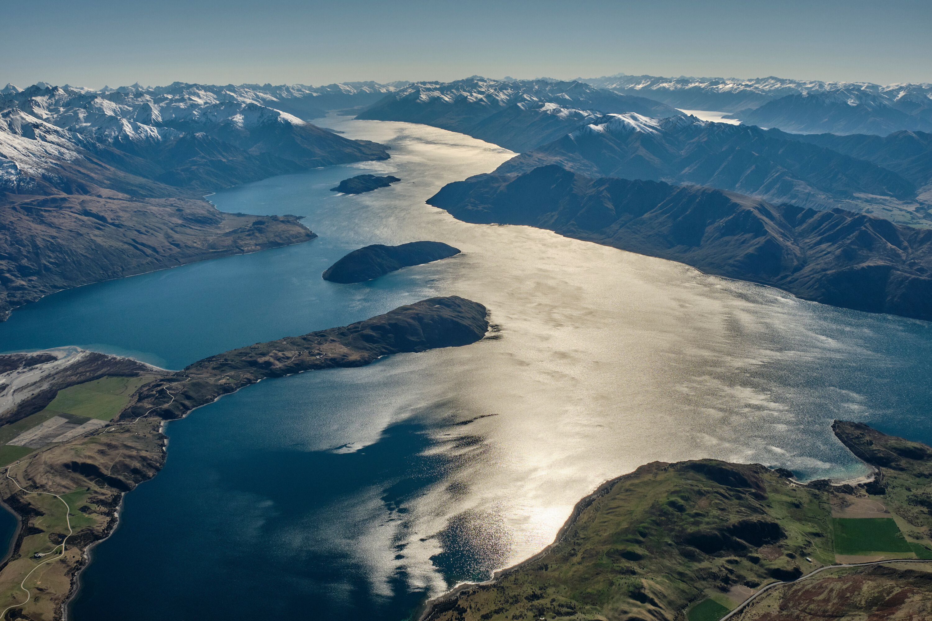
Mauri
  It is from the time of creation the ‘life force’ or ‘mauri’ originates.
  Mauri comes from the gods, transcends the ages, was vital for life and vitality then and down the ages.
  Mauri represents a connectedness to the beginning of time. All objects, animate or inanimate possess a mauri: water, trees, flora and fauna, and stone.
  The many Atua (demi-gods) are guardian or kaitiaki of their domain, over land, water, flora and fauna.
  In this context the function of tapu or restriction arises, deferral by mortals to the demi-gods, eg; Tāne or, Takaroa.
Eg; Taking a fish or tree required rituals to be observed, to appease the gods and satisfy this customary lore.

Slide 7
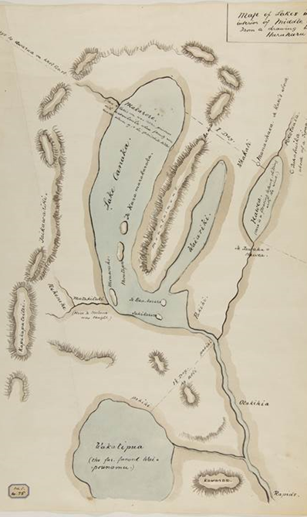
Myths, Values and Beliefs
Having addressed the central elements of Kāi Tahu cultural values, we can resume the story of populating the landscape with our core myths and ancestral associations and beliefs.
A storyline involving waka, the manner in which our ancestors arrived in this land on their momentous oceanic journey from the distant homelands.
They came from the islands of Te Moananui a Kiwa, Hawaiki nui, Hawaiki roa he Hawaiki pamamao (The great ocean of Kiwa, the great Hawaiki, the long Hawaiki, the distant Hawaiki).

Slide 8
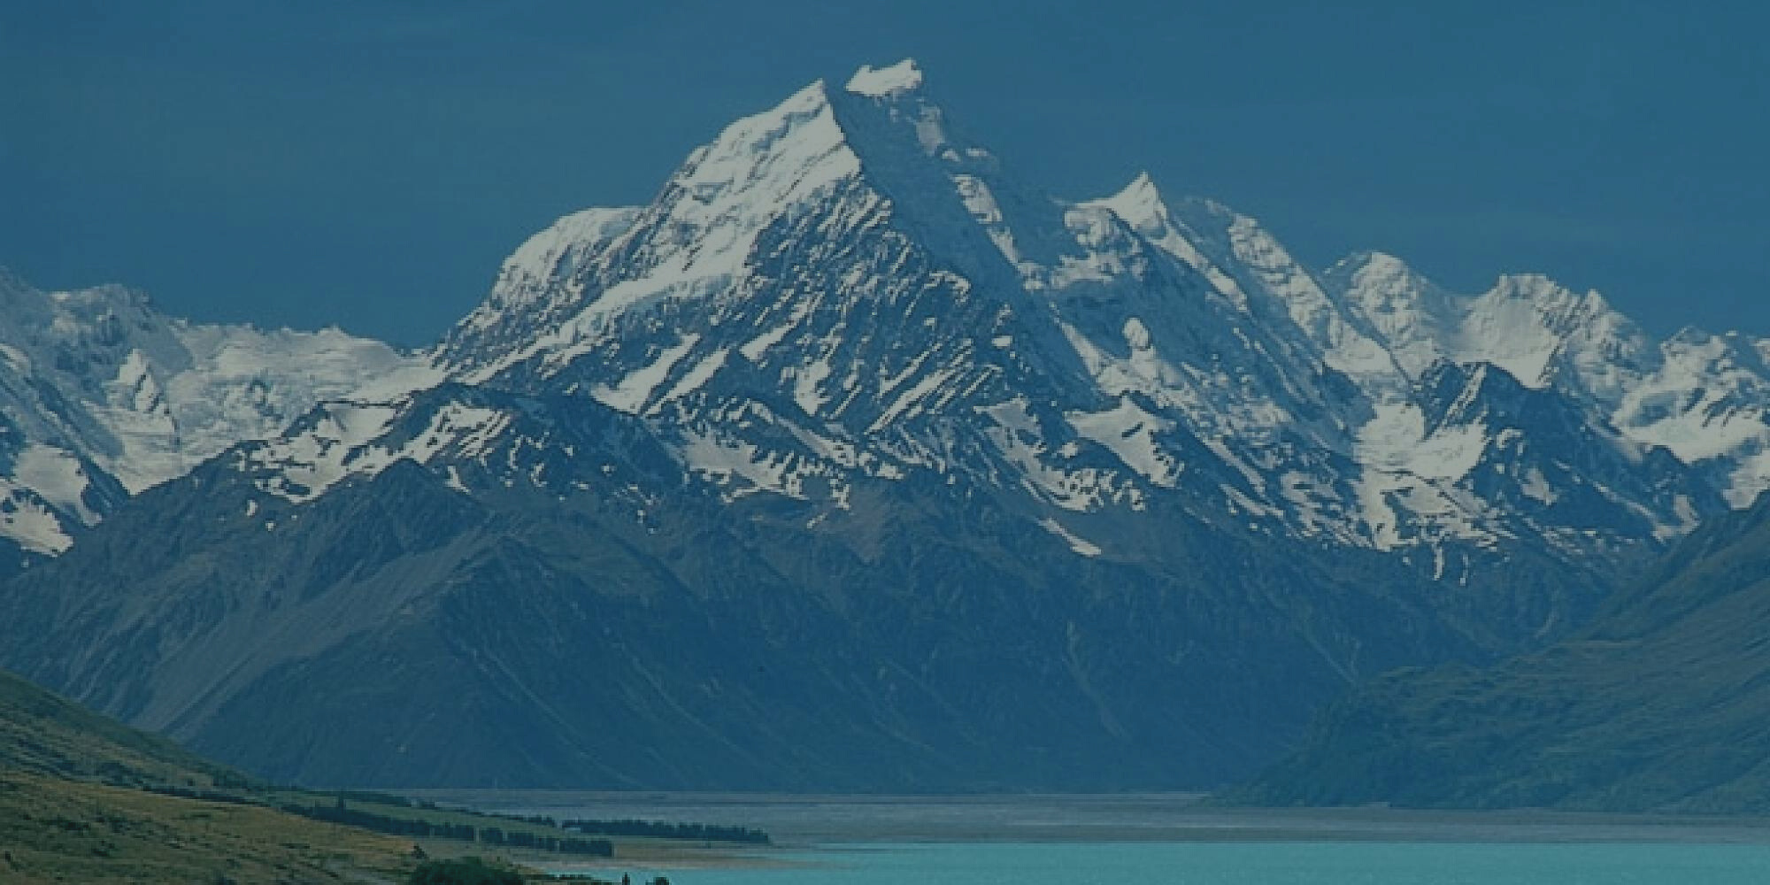
Te Waka o Aoraki
Te Waka o Aoraki carried the sons of Rakinui from his first marriage to Pokoharuatepo.
They descended to earth from their celestial home to visit Papatūānuku (2nd wife) and her children.
After voyaging around the great expanse of ocean, it was time to return to their celestial home, however their karakia was faulty.
The waka listed, the brothers led by Aoraki clambered to the high side of the waka, and turned to stone
The resulting land mass became known as Te Waka o Aoraki (South Island), the highest peak named Aoraki.

Slide 9
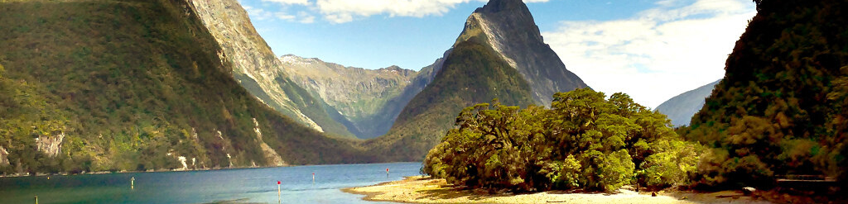
Tūterakiwhanoa
  The nephew of Aoraki, Tūterakiwhanoa was given the responsibility to determine the whereabouts of his uncles.
  He discovered they and their waka had become an island in the vast ocean.
  He set about with his adze ‘Te Hamo’ shaping the waka into a place fit for human habitation, forming peninsulas, estuaries and places for settlement.
  On sighting Piopiotahi (Milford Sound) he thought it was so beautiful that people would not move on, so he released sandflies to discourage lingering.

Slide 10
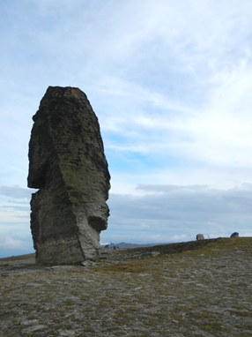
Te Waka a Raki
This waka was responsible for transporting ogres such as:
  The Pouakai, a gigantic man-eating bird
  The Karara-hua, a deceitful lizard who lured unwitting spouses to their death
  Kopuwai (known today as the Obelisk) who rests on top of the Old Man Range and his pack of two headed dogs that would prey on those who strayed from their travelling party.
All three ogres were associated with the inland area of Otago and linked to the earliest people of this land, the Rapuwai, associated with the Waitaha arrivals.

Slide 11
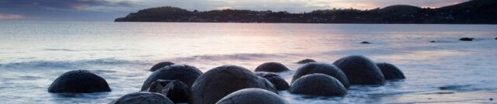
  The Āraiteuru waka became waterlogged in heavy seas off the Waitaki River mouth.
  Losing some of its cargo on Moeraki beach (Te Kaihinaki – food baskets) and was eventually wrecked at Matakaea (Shag Point).
  The many passengers aboard the waka who made it ashore explored the southern area of the South Island (Te Waipounamu / Te Waka o Aoraki / Te Waka a Maui).
  There was one requirement and that was to be back at camp before light fall.
  Most did not make it and were turned to stone and now form the mountains throughout the region, in some accounts including Aoraki.
  Many place names in Otago derive from the waka Āraiteuru.
The Āraiteuru Waka

Slide 12
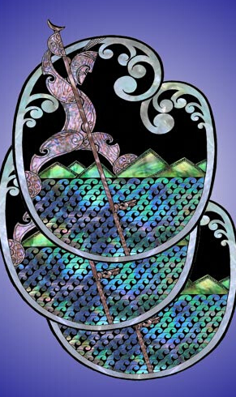
Rākaihautū and the Waitaha
The first people to lay their eyes upon the South Island were the Waitaha under the chieftainship of Rākaihautū, arriving in the canoe Uruao.
Rākaihautū dug three pools that were to give him a sign as to what the South Island had in store for them. In these pools, or puna, he saw:
He Puna Waimarie – Pools of Bounty
He Puna Hauaitu – Pools of Freezing Cold
He Puna Karikari – Pools Dug by the Hand of Man
This foretold that the Waitaha people would encounter waterways full of food for the people, lakes that would be freezing beyond all belief – the glacial pools, and the lakes excavated by man.
Rākaihautū carried an enormous spade ‘Tūwhakaroria’, plunging it into the soil and a lake would appear.
They include the lakes Rotoroa and Rotoiti, Takapō, Pūkaki and Ōhou and in the QLDC district the great lakes Hāwea, Wānaka and Whakatipu-wai-Māori and so on...

Slide 13
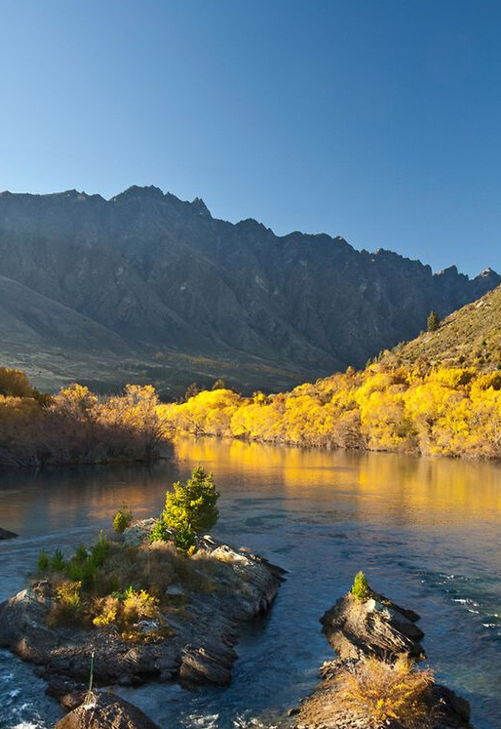
Kāti Māmoe
The Kāti Māmoe crossed from the North Island and over time intermarried with the Waitaha.
Rakitauneke was a mobile Kāti Māmoe chief, residing at places such as Goose Bay, Opihi, Otago Heads, inland Otago, West Coast, mouth of the Matau-au and Wai-o Mokomoko (near Bluff).
Tuwiriroa a contemporary of Te Rakitauneke lived permanently for a year or two at Tititea (where the Kawarau River leaves Lake Wakatipu).
His daughter Hākitekura made the celebrated swim from Kelvin Heights (Te nuku o Hākitekura) across Wakatipu-wai-māori (Wakatipu) to the foot of Ka Kamu a Hākitekura (Cecil Peak).
After a Kāi Tahu woman died in the village Tuwiriroa decided to relocate to Taieri Mouth where he built Motupara Pā.

Slide 14
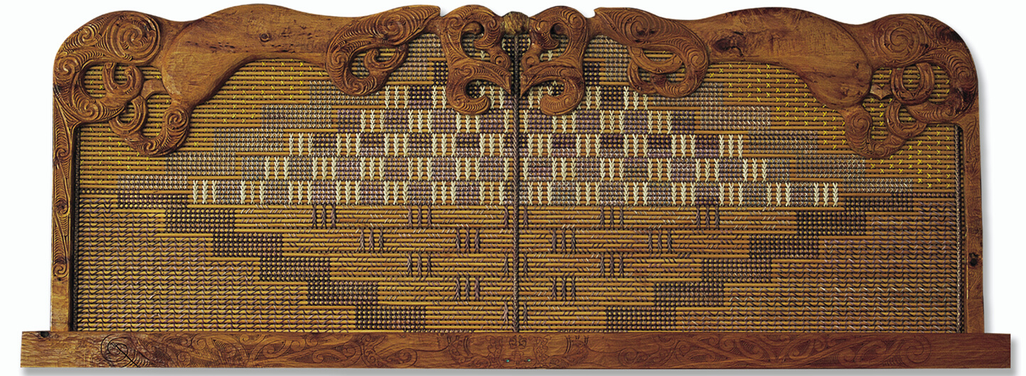
Kāi Tahu
  Te Weka, the son of Te Rakitamau of Taumutu was sent to the Waitaha village at Parakarehu (Wānaka) to obtain a Waitaha wife for his father.
  Things went awry and turned into a routing of the Waitaha. Their chief Potiki-tautahi who died in this incident, he was the uncle of Te Weka.
  The Waitaha then abandoned the Wanaka area but remained at Ōhou in association with Kāti Māmoe.
  A leading Kāi Tuahuriri chief Kaweriri with his brother Parakiore led a war party departing from Kaiapoi.
  The rationale for the expedition via inland Otago was to exact utu for recent deaths of Kāi Tahu chiefs at the hands of Kāti Māmoe in seperate incidents at Ōhou (Ohau) and Waitete (Waitati).
  The pathways of Kaweriri and Tū Temakohu (Kāti Mamoe) intersected at Waitaramea, on the Fiver Rivers Plain in Southland where Kaweriri was killed by Tū Te Makoha.

Slide 15
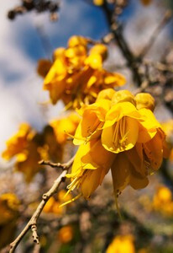
Peace/ Poupoutunoa
Rakiihia, a senior Kāti Māmoe chief sought a truce with Kāi Tahu, to settle prolonged and intermittent difficulties.
Visiting the Kāi Tahu chief Te Hau-tapu-nui-o-Tū (Te Hau) at Kaiapoi pā, key marriages were arranged, Rakiihia to Hinehakiri, a sister of Te Hau, while Kohuwai the granddaughter of Rakiihia married Honekai the son of Te Hau.
Rakiihia returned to Pukekura (Taiaroa Head), Te Hau accompanied him on his return, where Rakiihia was mortally wounded in a domestic incident.
Further skirmishes occurred in South Otago and a truce was recognised by the boundary marker ‘Poupoutunoa’ near Clinton.
Some further fighting took place when Pukekura (Ōtākou) chiefs intent on enforcing peace, attacked a section of Kāti Māmoe in South Otago.

Slide 16
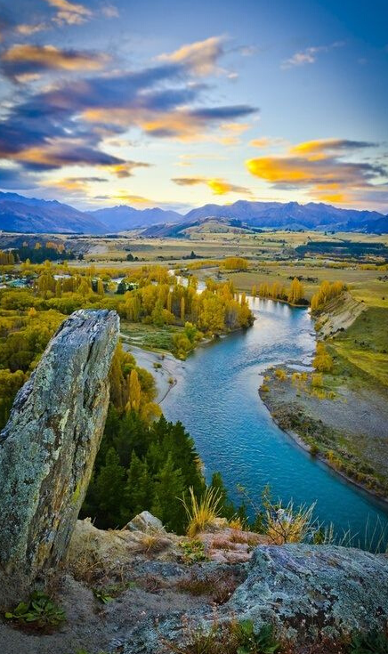
Ara Tawhito
Trails into the interior included via the
a) Waitaki Valley and through either the Danseys or Lindis Pass;
b) the Waihemo and Pig Root;
c) the Waikouaiti catchment;
d) Taiari (Taieri) River catchment;
e) Mata-au or Mataura River catchments, including localised variations.
Returning to the coast by mōkihi craft on the Waitaki, Taiari (Taieri), Mata-au and Mataura rivers or the option of return via a variety of land routes.

Slide 17
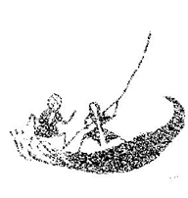
The Natural Bridge across the Kawarau upstream of the Roaring Meg linked with trails south via the Nevis or north toward Wānaka via the Cardrona.
Many subsidiary trails linked to temporary campsites from which hunting expeditions criss-crossed the interior of Otago.
Waka were used on lakes as well as mōkihi (raupo reed rafts), mokihi were also used to cross or travel downstream on rivers, often as far as the coast conveying people and resources.
Mōkihi had better load carrying capacity, demonstrating better stability and safety in the turbulent South Island rivers than the river canoes, or waka tiwai, used by Māori elsewhere.
The ready availability of raupō in the interior of Otago ensured the mōkihi were utilised on the Mata-au, making the task of transporting people, mahika kai and stone resources to the coast possible.
Travel through the Interior

Slide 18
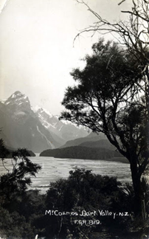
Pounamu
The Dart River umu-ti site was associated with the pounamu fields found at the head of Lake Wakatipu.
Pounamu was highly prized for its ability to hold an edge suitable for weapons, tools and ornaments.
Because of its durability pounamu taoka was passed from generation to generation as treasured whanau heirlooms and carries much mana.
The Dart River (Te Awa Whakatipu) settlement site acted as a temporary camp site for expeditions to gather, initially shape and then convey raw pounamu by waka and mōkihi raw pounamu to the coast.
The Waitaki chief Huruhuru drew a sketch of the interior for Edward Shortland. It showed several lakes, one named ‘Wakatipua’, that was ”..celebrated for the pounamu found on its shores and in the mountain torrents.”

Slide 19
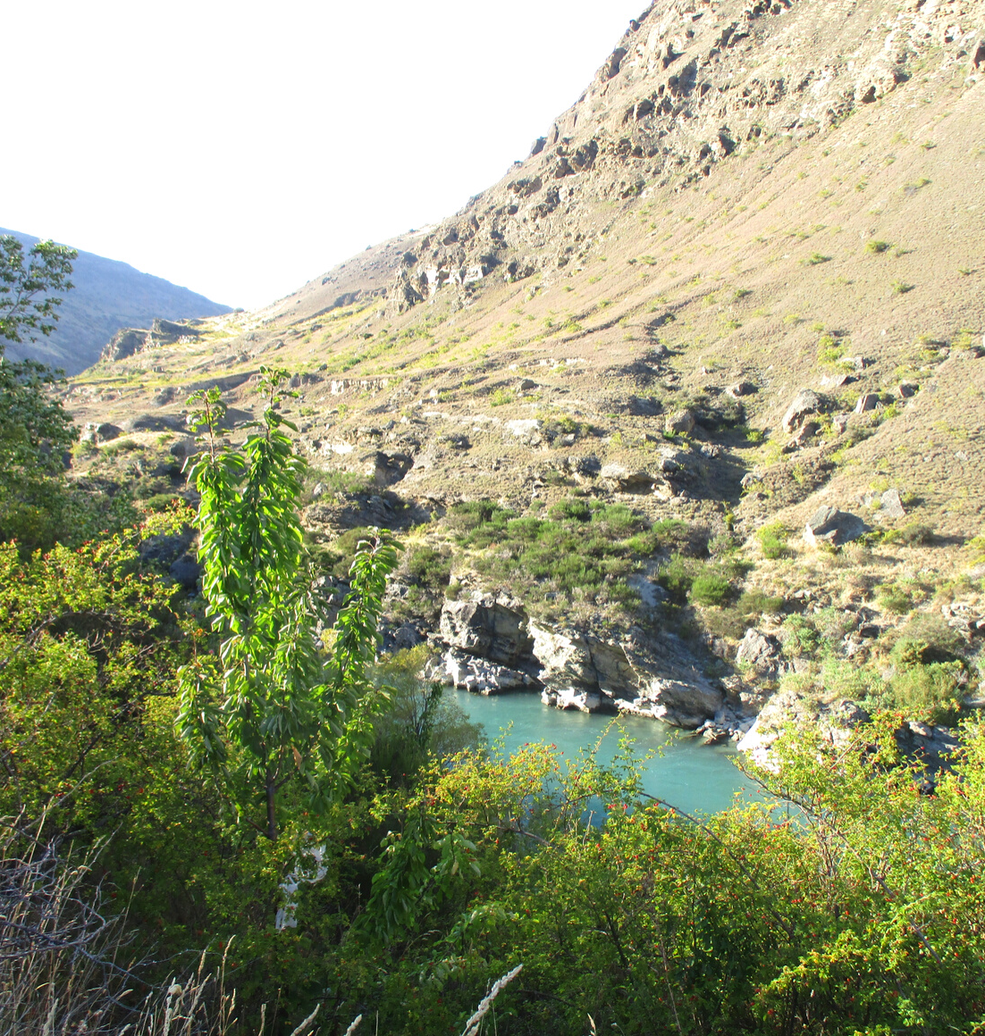
  The term ‘mahika kai’ refers to places where food and other resources were gathered or produced.
  Mobile small groups used trails, temporary or seasonal camp sites and sustained themselves in a hunter gatherer style.
  During this period, the Waitaha applied their names and mythological traditions to the landscape.
  Resources sought included eel, kanakana, kiore, birds, trees, fern or tī kouka patches, flax, raupō, taramea, pounamu, schist and porcellinite.
  When the moa were abundant, extended inland summer visits took place. Whanau traversed to all parts of the district to find stones, plants and other resources which were adapted for use.
  As autumn drew on, inland hunting groups returned to coastal villages, carrying their kits of preserved food, dried moa, stone materials and materials such as mountain daisy, leaves and lacebark.
Mahika kai

Slide 20
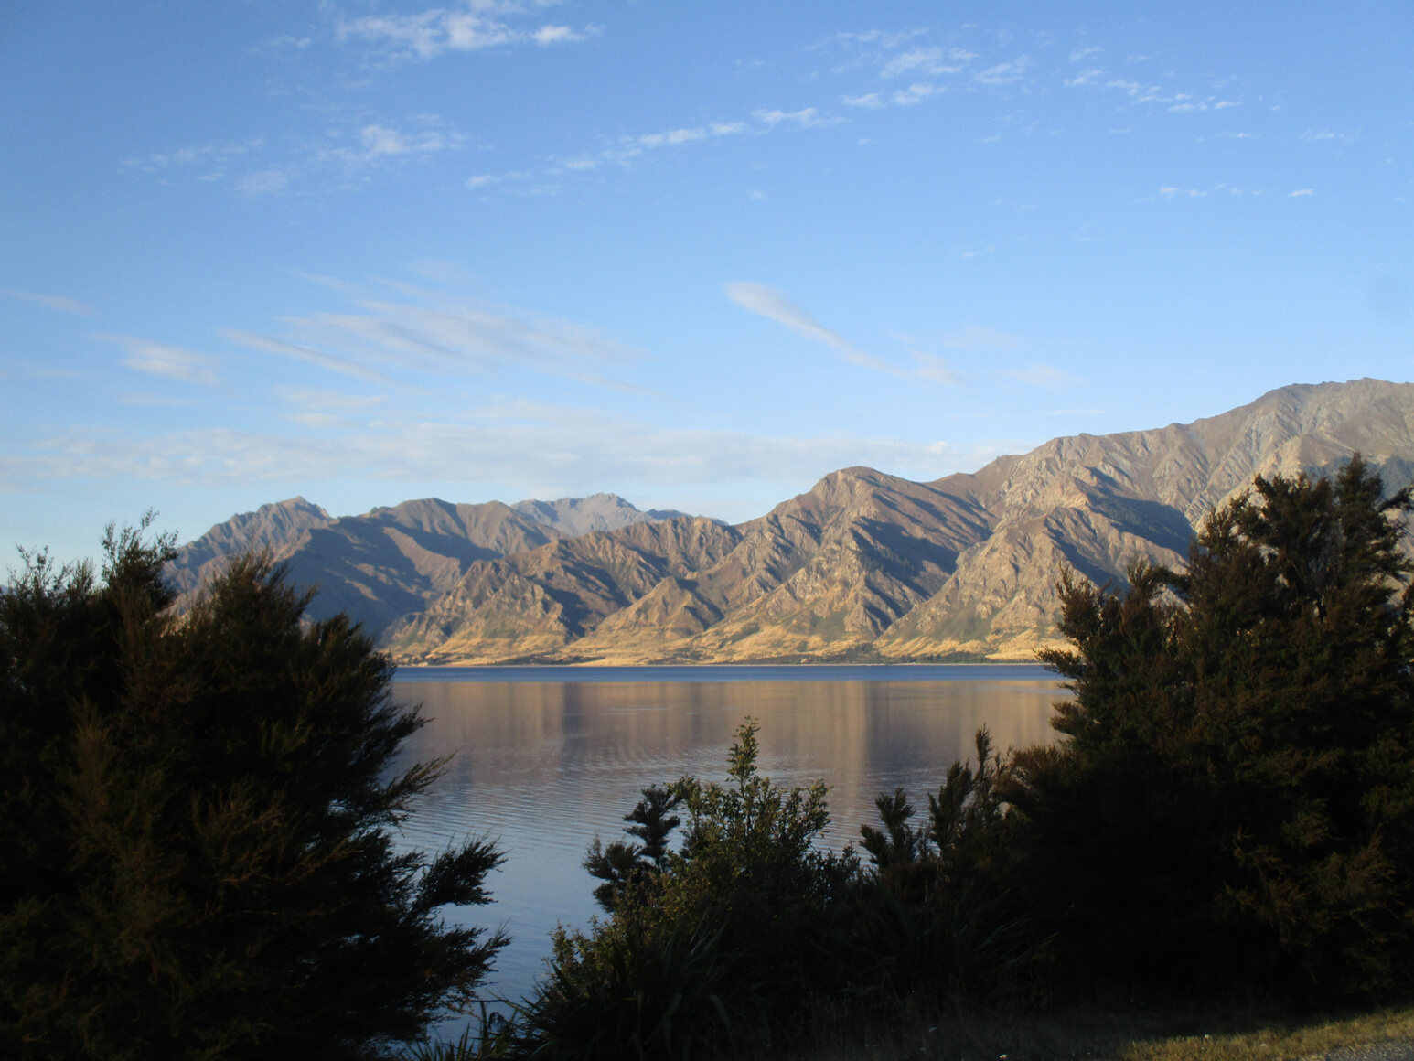
Snapshot of Inland Otago places associated with the Te Puoho raid of 1836
  In 1836 the Ngāti Tama chief Te Puoho and a taua of about 50 warriors, travelling from Nelson down the West Coast, entered Otago through the Haast Pass, with the purpose of attacking Kāi Tahu in their southern stonghold.
  At Makarore a hunting group of nine people were surprised and taken prisoner, two children were killed.
  Te Puoho sent two scouts to Manawhaia (The Neck), with a prisoner to guide the way. The head man Te Raki overpowered the scouts.
  Te Raki then escaped with his party of five people by mōkihi down Lake Hawea to alert a group camped at Te Tawaha o Hāwea (at the bottom of Lake Hawea) .
  Most of these people escaped via the Lindis Pass, floating down the Waitaki River by mokihi to the coast.
  Te Puoho then came upon another group of hunters at Takikarara, an island near Wānaka, where the head man Te Mohene and four people were captured.
  From Takikarara, Te Puoho headed up the Cardrona, across the Natural Bridge and up though the Papapuni (Nevis) and likely dropped in to the Garston area on their way toward Tuturau.

Slide 21
Other Inland Connections
  Villages not mentioned in the Te Puoho account include Nehenehe on the Matukituki River (Matakitaki) and several at Lake Hāwea.
  Hunting groups from the lower Waitaki, Moeraki and Waihao localities frequented the lakes area.
  In 1844, the Waitaki chief Huruhuru indicated to Edward Shortland that the journey inland to Hawea from the lower Waitaki coast was nine days by foot .
  Karetai of Ōtākou and was born at Lake Hawea, indicating an association of the hapu Kāi Te Pahi with the interior and lakes area.
  Matahaere who had an association with Southland and Ruapuke as well as east Otago was known to be seasonally in the interior.
  Haimona Rakiraki (Kāti Mamoe), from South Otago, as a lad was at Lake Hawea when Puoho came through. He escaped and was brought down to the Molyneux by Haereroa.
  Reko, originally from Kaiapoi but living in the vicinity of Tuturau had developed a good knowledge of the interior, acting as a guide for the pastoralist Nathaniel Chalmers, the first European to venture inland to the great lakes Wakatipu, Wānaka and Hāwea.

Slide 22
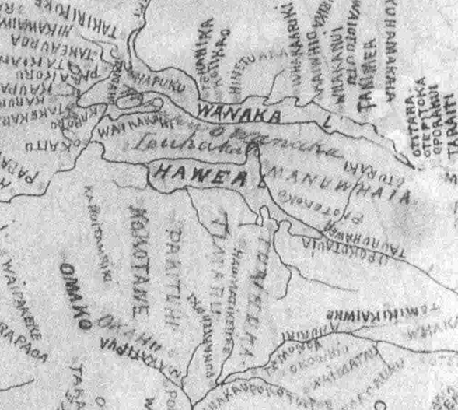
H K Taiaroa 1880 Report
The ‘Ngāi Tahu 1880’ mahika kai report by HK Taiaroa is a priceless record of Kāi Tahu mahika kai values and places. His interview with Merekihereka Hape at Waikouaiti, 26 May 1880 recorded the following issues;
Our food gathering sites have simply been taken away;
Our food gathering sites have been taken, we have been deprived of food (sources), we go to our food sites only to be harassed by the Pakeha;
We did not agree to this (in the land sales);
We do not have any money;
Our old die because there are no hospitals, we say that our settlements and food gathering sites should be returned (to us), this is why these names are listed here (placenames).

Slide 23
Tiramorehu speaking at the Smith Nairn Royal Commission in 1879, MA 67/7, stated:
“All that is left now are the big rivers where they run right up into the mountains, and all our mahika kai in regard to eels, inaka and other fishes are all dried up. Stone buildings and houses are standing on what were mahika kai.”
“The rivers are closed to us and reserves are insufficient to support us. The young men may be able to work at shearing and harvesting but for a large part of the year there is no work to do.”
“They [Kāi Tahu] complained that, although they have a closed season for eels, the Europeans catch them all the year round.”
“In olden times the natives had control of these matters, but the advent of the Europeans and the settlement of the country changed the state of affairs and destroyed the protection that formerly existed, consequently their mahika kai (food producing places) are rendered more worthless every year.”

Slide 24
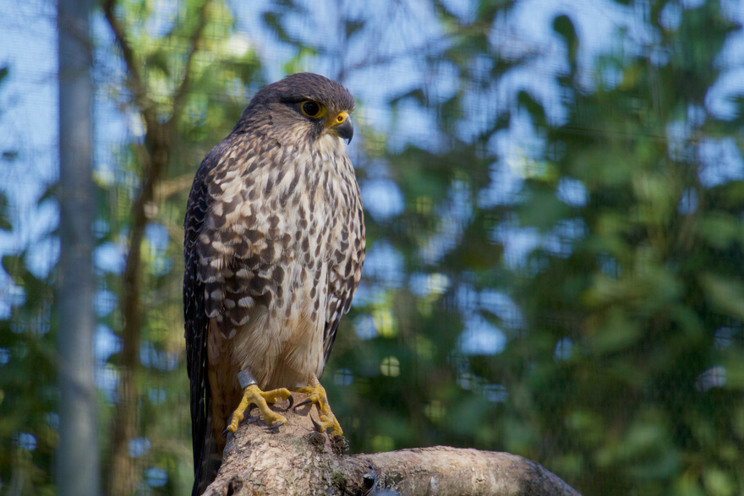
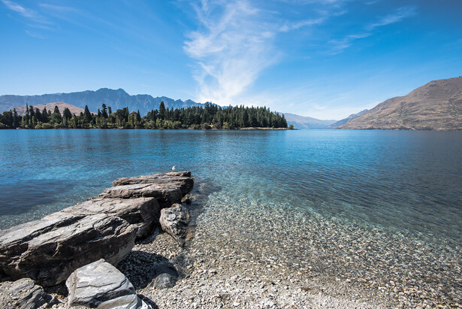
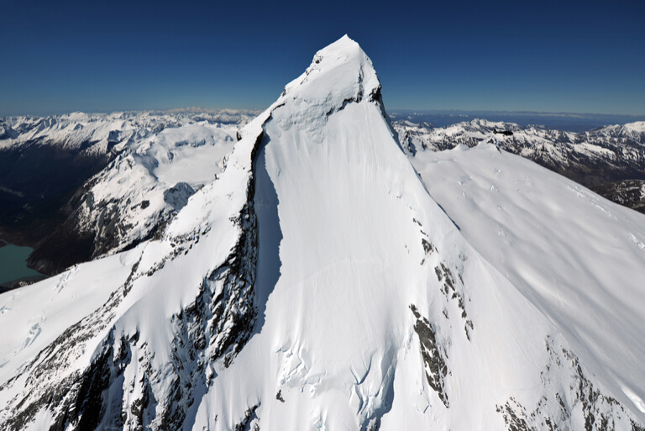
The Ngāi Tahu Claims Settlement Act 1998 include;
  Taonga species list of birds, plants and fish with provisions.
  Statutory Acknowledgements for Lake Hāwea, Lake Wanaka, Tititea (Mt Asiring), Pikirakatahi (Mt Earnslaw), Whakatipu-wai-māori (Lake Wakatipu), Mata-au (Clutha River);
  Tōpuni for Tititea, Pikirakatahi and Te Koroka.

Slide 25
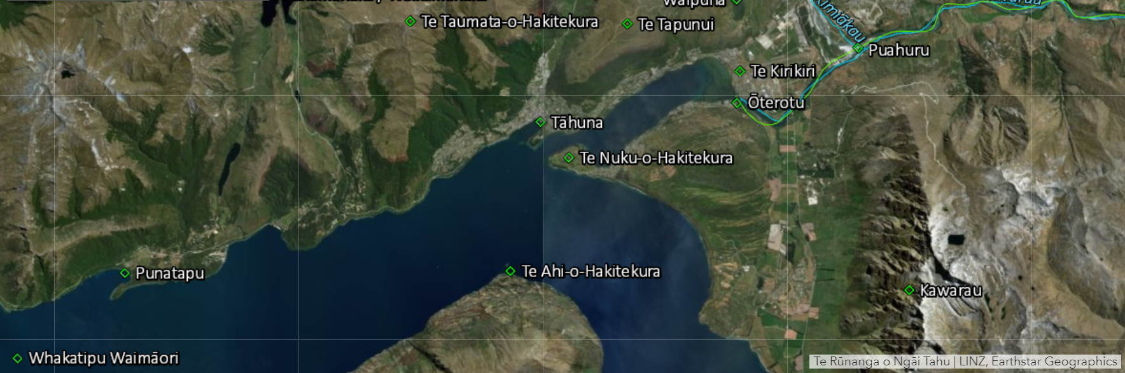
Kā Huru Manu – Ngāi Tahu Mapping Project

