Slide 1
Te Pūtahi Ladies Mile Variation
Transport Summary
John Parlane
Ladies Mile Property Syndicate LP

Slide 2
Desired Outcomes
Successful Higher Density should result in
A higher proportion of public transport use
Higher levels of walking and cycling
A lower % of car trips (but a higher total number of car trips)
Higher Population should result in the growth of more non-residential activities such as
Schools
Shops
Jobs
I support all of these outcomes because they have positive transport effects so I support rules that enable higher density.
I don’t support rules requiring higher density because of the risk of adverse transport outcomes.

Slide 3
Density Research
Most studies linking density and mode share rely on the Newman and Kenworthy (1989) data.
Paul Mee’s showed the problems with that approach.
Mode Share is not caused by density alone.
The destination end of the trip matters equally.

Slide 4
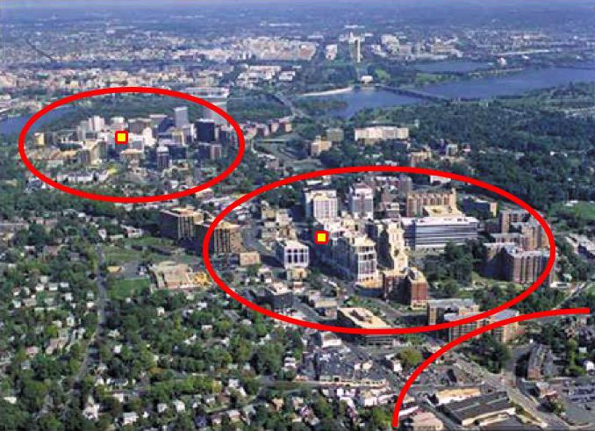
Transit Oriented Design
Transit Oriented Design (TOD) density targets are not predictors of mode share.
Overseas examples of density and mode share can be due to investment in high quality mass transit systems.
We can’t simply look at overseas examples of high mode share and assume the success was due to density.
Bus systems typically have more stops than rail.

Slide 5
minimum density rule issues and
How This affects Transport
Transport Issues of a Minimum Density Rule
The minimum density of 60 dwellings/ha might not be viable (Tamba Carlton evidence para 18)
The short and medium term feasibility of development is reduced by the minimum density rule (Susan Fairgray rebuttal para 66)
This means that achieving the desired mode share in a timely manner is unlikely
I simply don’t support a rule requiring high density, because that would prohibit medium and lower density development occurring if high density doesn’t occur
Transport policy must be pragmatic and not based on an assumed land use outcome

Slide 6
Rebuttal of Council Transport Experts (1)
Risks of Introducing a Minimum Density Rule
Development could be delayed by the rule
Some sites won’t develop in the manner expected
Average density could be reduced by the rule due to undeveloped sites
In turn we would expect much lower public transport use
The risk of delay to schools and shops means that more car trips will be required.
Transport planners need to be pragmatic and assuming full development, particularly when economists are raising caution, is a flawed approach in my view.

Slide 7
Rebuttal of Council Transport Experts (2)
Population more important than minimum density
Buses can have multiple stops in an area, but the TOD approach ais based on trains that have only a single stop
Schools, shops and services require a resident catchment which can be spread over a wider area
Population can be increased through expanding the residential area because it is served by buses
Council says 40 to 60 units per ha range
(see Shields answers to Commissioners research used and Expert Caucusing)
When setting a minimum rule why use 60?

