Slide 1

Housing Affordability Taskforce Workshop
Monday 10th April 2017

Slide 2

Welcome and Introductions
Mayor Jim Boult and Councillor John MacDonald ( Chair )

Slide 3
What’s the problem?
Ian Bayliss (QLDC)
and
Julie Scott (QLCHT)

Slide 4
Ian Bayliss, QLDC Manager Planning Policy

Slide 5
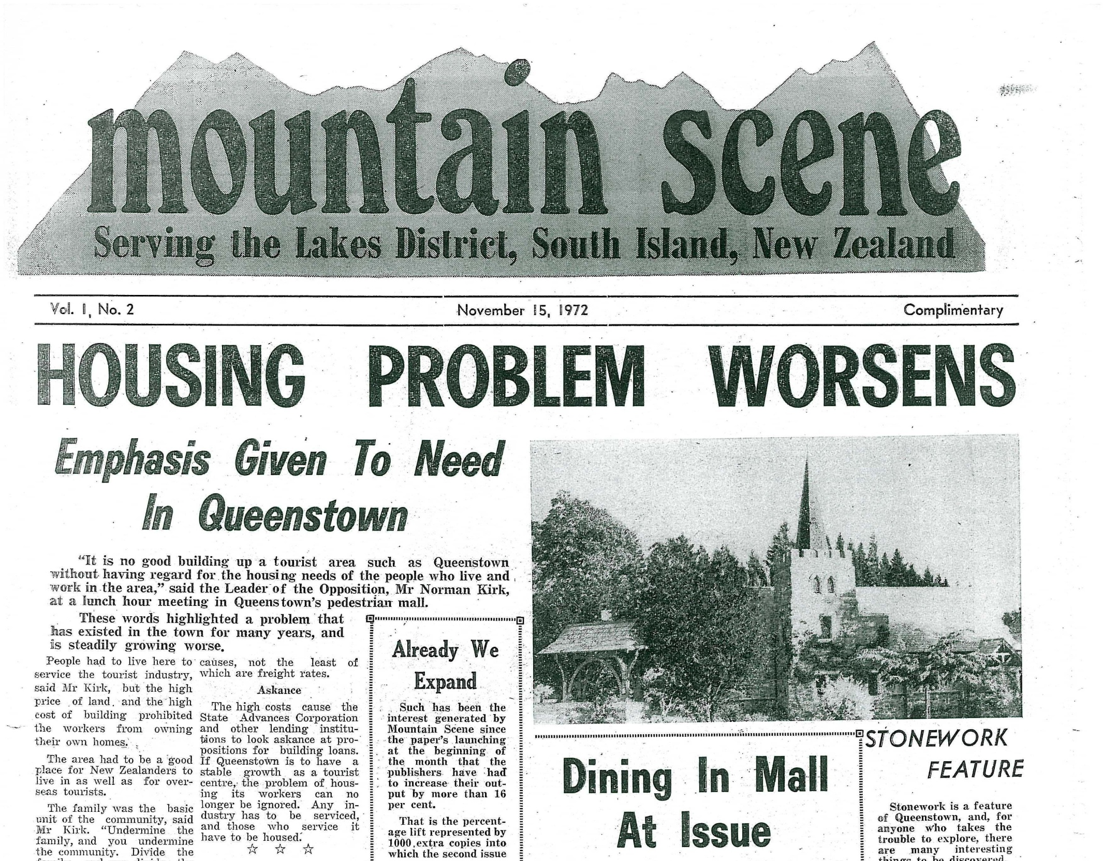
Council position on PDP
Notes:
Long history of awareness and concern about the availability of affordable housing in Qtn
1972 article says it’s a longstanding problem
Could have put up 50+ clippings

Slide 6
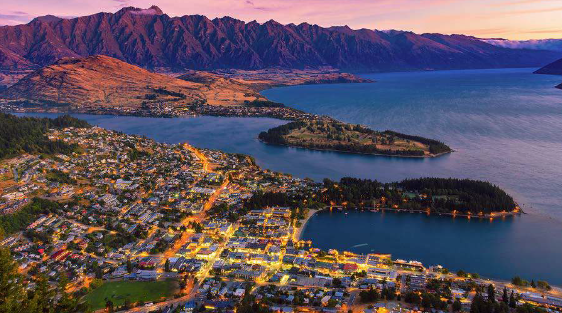
Drivers
Notes:
Drivers are somewhat obvious – they are also an opportunity
People will pay a premium to own property in a high amenity area with a buoyant economy and easy access to world class recreational opportunities.
International airport with frequent flights 1,801,564 passengers last year (up 17%)
Economic settings encouraging property investment - taxation, banking, foreign land ownership, accommodation supplement
Modest community housing sector relative to UK and other places
High construction costs – small scale building sector
Practical physical constraints splendid geography – mountains lakes rivers flood plains, unstable geology
Precious landscapes $2.6 billion annual tourism spend
28% of the housing stock in 2013 was vacant
Planning constraints – UGB’s

Slide 7
Economic
difficulty in recruiting and retaining staff
- high turnover at all levels
Notes:
Invidious >1m club
Less affordable than Auckland
Highly skilled, professionals, nurses, teaches, public sector
Service industry workers – hotel and ski workers – large numbers in Qt with moderate wages
Threat to multi b$ tourism industry

Slide 8
Economic
Reluctance to expand businesses or attract new business
Notes:
Ratio of median house $ to average annual earnings getting worse, particularly in the last few years.
Cost of housing relative to incomes in NZ as a whole is problematic OECD and Demographia
QT is 2x as bad as the average and 3x as bad as Dunedin

Slide 9
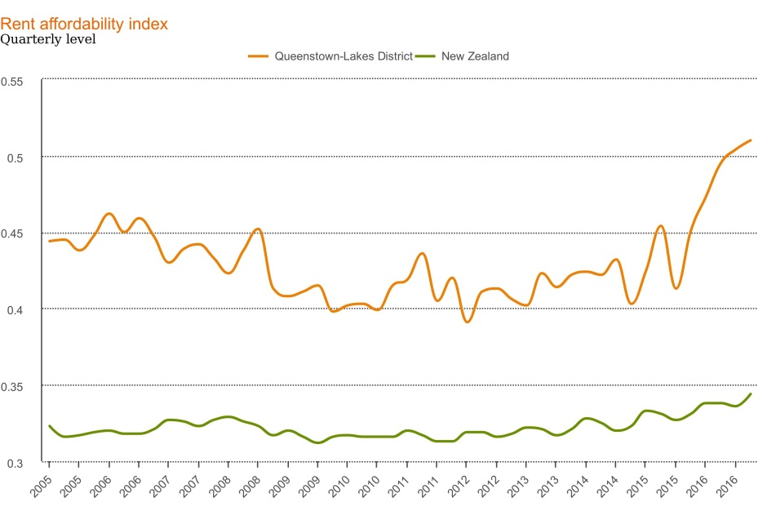
Economic
Proliferation of visitor accommodation - Airbnb
Ratio of Average Household Incomes to Average Rents
Notes:
People renting in Qt spend over half their income on housing
Has been a problem for a long time but now taking off
Particular impact on people with middle – low wages
Airbnb taking up increasing share of housing stock – security of tenure
28% vacant dwellings 2013

Slide 10
Economic
Not a new thing
Notes:
People renting in Qt spend over half their income on housing
Has been a problem for a long time but now taking off
Particular impact on people with middle – low wages
Airbnb taking up increasing share of housing stock – security of tenure
28% vacant dwellings 2013

Slide 11

Social
High turnover of people
Housing stress – effects on individuals, relationships, people working multiple jobs, compromise on heating
Notes:
Putting down roots
Aging in place

Slide 12
Social
People with moderate incomes struggle to get ahead here compared to other places
‘Just too hard’ – move on
Effect on family formation and the make-up of the community
Notes:
Diverse stable community
Lost investment in people, places and businesses

Slide 13
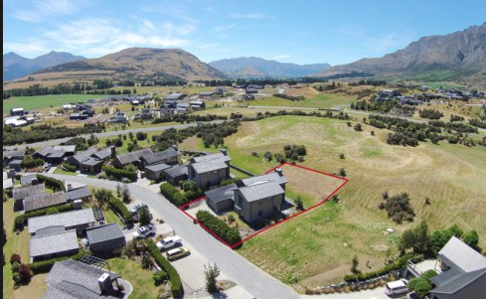
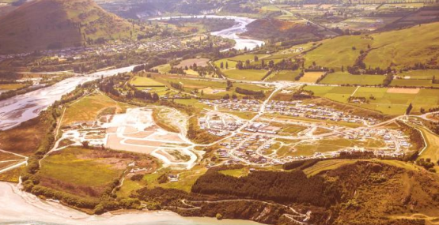
Environmental
Zoning large amounts of land for urban development is challenging
  facilitating infrastructure for growth with tiny ratepayer base
  physical geography
  natural hazards
  precious landscapes
  scarcity and amenity
Notes:
Convoluted geography and a sensitive receiving environment
Natural hazards pizza – land is steep and could fall down or flood and liquefaction prone
Precious landscapes – key part of $2.6 billion annual tourism spend.
Litigious planning environment
We’re doing it anyway but facilitating and funding LG component of infrastructure and planning for large land releases with a tiny ratepayer base (15,000 households) super difficult
Last 2 years consent numbers and new dwelling numbers were 2x the 10 year average but prices were still skyrocketing.

Slide 14
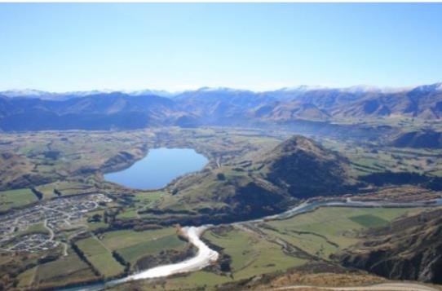
Environmental
People commuting long distances from cheaper places to live has a range of issues
Notes:
Surprising traffic congestion
Commuting time is a major living cost
Parking impact on Qt town centre

Slide 15
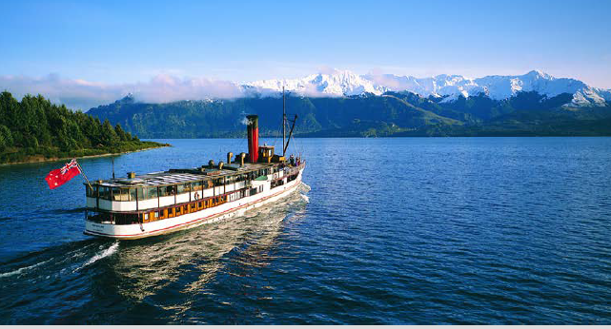
Great opportunities
strong sustained community support for addressing the issues
evidence private and assisted housing sectors can coexist and thrive
NZ leader in inclusionary housing policy
district plan under review
Notes:
Sustainable enduring housing solution – beyond political cycle
Virtuous cycle from making Qt a destination of choice for quality workers and businesses
Not undermining Queenstown as a premium location to live and visit.
Case for PC24 undefeated at EC and HC
Viability of development – e.g Jacks Point selling hundreds of lots within hours of each release.
Quantum to make a difference achievable (scott)

Slide 16
Julie Scott, Executive Officer
Queenstown Lakes Community Housing Trust

Slide 17

EXTENT OF THE PROBLEM
430 eligible households on our waiting list seeking some form of housing assistance.
Increased by 180 in past 12 months.
Notes:
Eligibility guidelines – FT employment, residency status, no other property, 6 month’s min, income cap – NOT transients

Slide 18
EXTENT OF THE PROBLEM
1138 households registered their interest
150 have been housed by QLCHT
195 were ineligible
363 no longer require QLCHT assistance
430 remain on the waiting list
Notes:
We’ve only been able to assist 16% of those eligible who have applied.
Many of the 363 have left town for housing reasons.

Slide 19
INDEPENDENT RESEARCH COMMISSIONED
1100 renters completed online survey in April 2016.
74% had either citizenship or permanent residency.
87% of respondents who rented in other parts of NZ consider affordability in the District worse than the rest of the country.
92% of respondents consider housing affordability a barrier to their long term commitment to the District.
Notes:
The final finding most concerning for all factions of the community – particularly employers.

Slide 20
INDEPENDENT RESEARCH COMMISSIONED
Common theme in qualitative responses included:
  Frustration and anger at high cost of renting and unreasonable ongoing rent increases;
  Affordability issues causing housing stress and forcing families to leave town - including long-term locals;
  Security of tenure is a constant issue for many.
Notes:
Rents have gone up by ~40% in the past 12 months.
The latest Massey University Home Affordability Report showed Central Otago Lakes home affordability fell 8.2 percent in the December-February quarter and the region was now 68% less affordable than the national average value. Median house prices in Central Otago Lakes were almost 14 times higher than annual wages.
Security of tenure ongoing issue for many years due to 11 month lease phenomenon.

Slide 21
SUMMARY OF THE PROBLEMS
Airbnb taking long term rentals off market.
Lack of rental supply driving rents to excessively high levels.
Increase in overcrowding of families.
Affordability issues causing housing stress and forcing families to leave Queenstown.
Notes:
Many families in ironic position where they pay more in rent than what they would if they had a mortgage.
Overcrowding story from Happiness House on Friday.

Slide 22
SUMMARY OF THE PROBLEMS
No incentive for builders to build entry level homes.
Security of tenure issues.
Property market jumped ~40% in past 18 months – cutting out first home buyers.
Notes:
Profit for builders is in high-end housing.
NZ leases cf. to Germany
People want to own their home for a variety of reasons – we will not retain cops, nurses and teachers in this town unless they have the ability to buy their own home.

Slide 23
CHALLENGES QLCHT FACES…
PC24 – needs strengthened and standardised.
Enforcement of existing Stakeholder Deeds.
Lack of a District-wide Housing Plan.
Shared Ownership programme unworkable in current market conditions.
Waiting list mounting while Trust seeks land for a large scale development.

Slide 24
WHAT HAPPENS IF WE DO NOTHING?
QLCHT waiting list grows.
More distressed families leave town.
Employers find it even more difficult to attract and retain key staff – effecting local economy.
Housing stress puts pressure on other core social services, eg Jigsaw, Happiness House.

Slide 25
WHAT HAPPENS IF WE DO NOTHING?
Schools, sports & community groups disrupted from families coming and going.
Households can’t progress along the
housing continuum.
Queenstown becomes another Aspen.

Slide 26
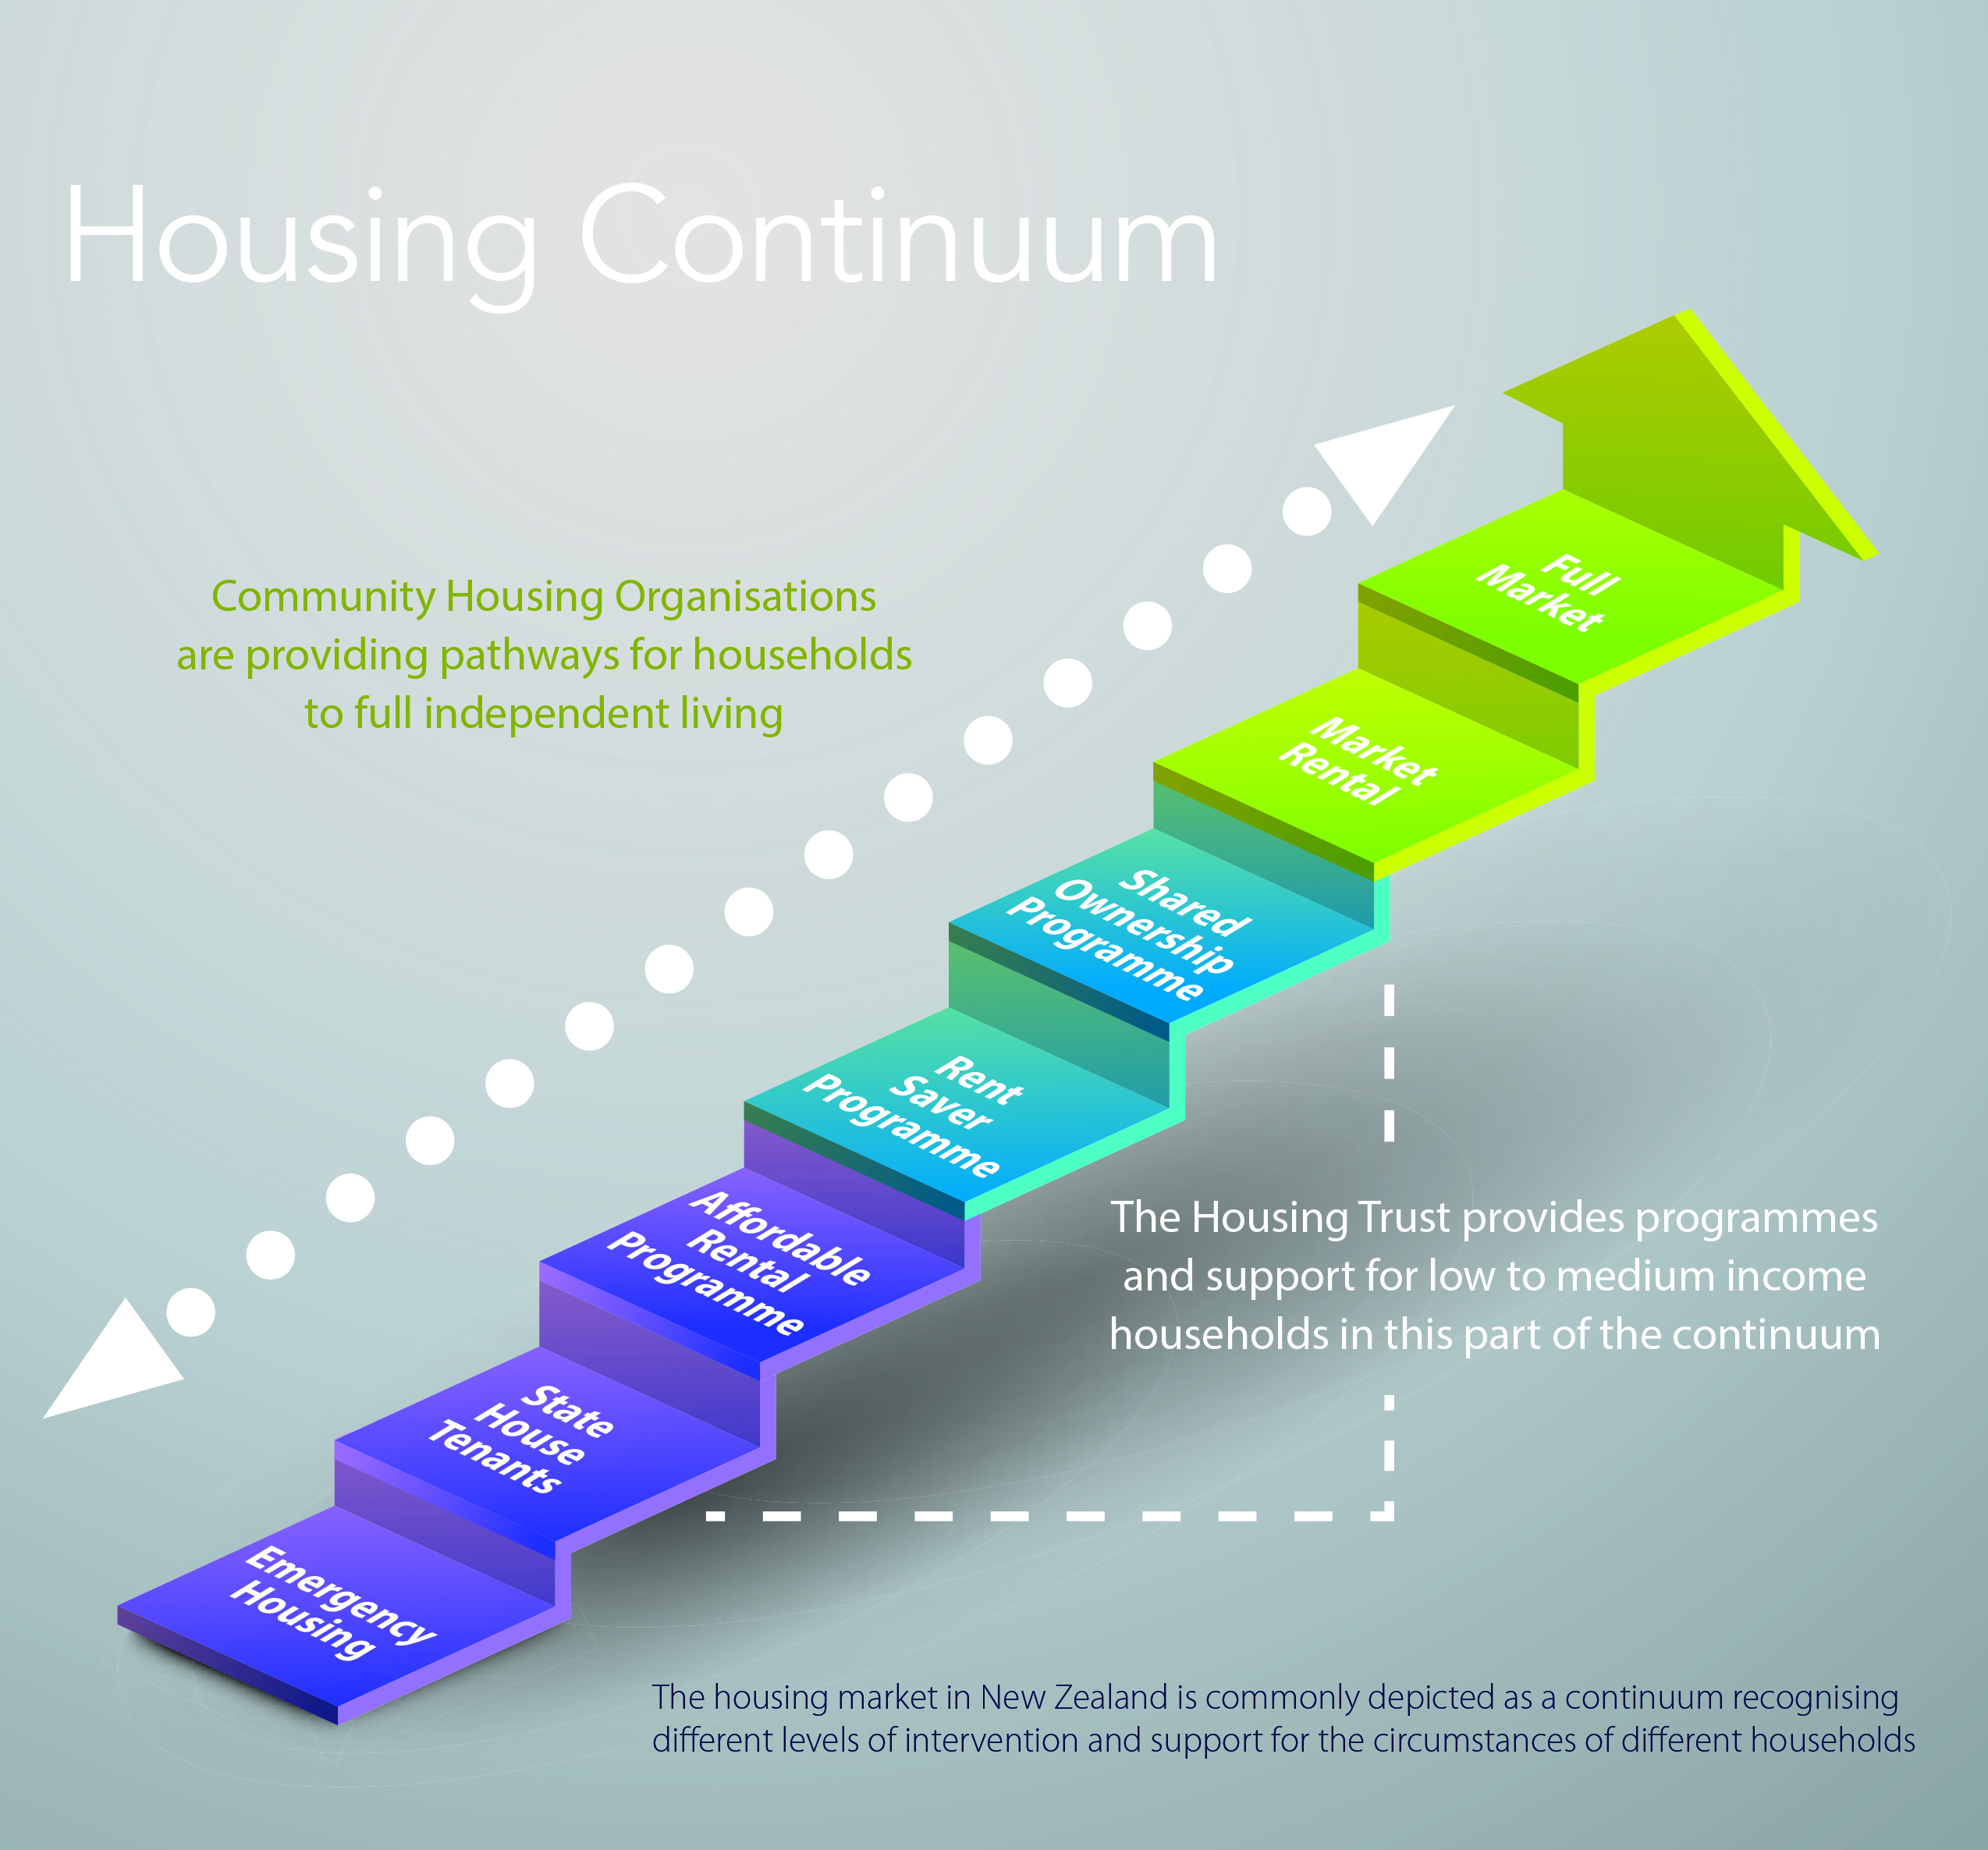

Slide 27
What’s happening elsewhere?
Scott Figenshow (Community Housing Aotearoa)

Slide 28

What’s Happening Elsewhere-
From Evidence to Action
Scott Figenshow
Chief Executive,
Community Housing Aotearoa
Queenstown Housing Affordability Taskforce
10 April 2017
Notes:
Introduction

Slide 29
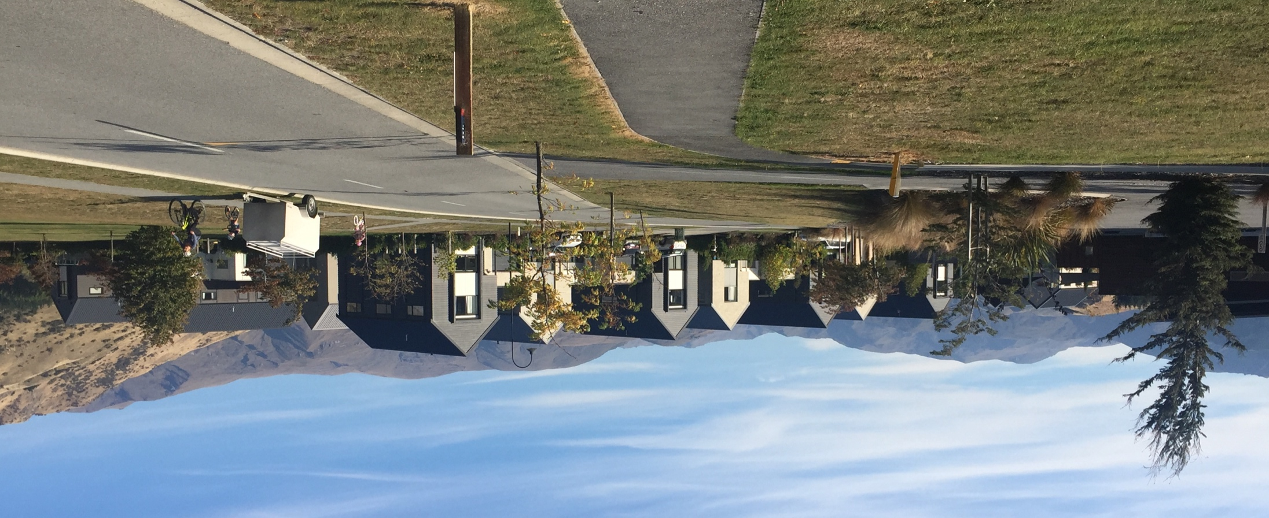
To Cover:
The national picture
Actions in high and medium growth cities
Evidence for Solutions
A range of interventions
Notes:
Photo: Nerin square – an early development by the QLCHT – made possible through the inclusionary programme and stakeholder deeds

Slide 30

Notes:
15,000 homes for 50,000 more people by 2030
Delivery at the rate of 1000 affordable and social homes per year
A Human Rights based approach, endorsed in NZ
Adequate means: Affordable, Habitable, Accessible, Security of Tenure and Culturally Appropriate
Pathways across the housing continuum,
Principles that drive the Continuum

Slide 31
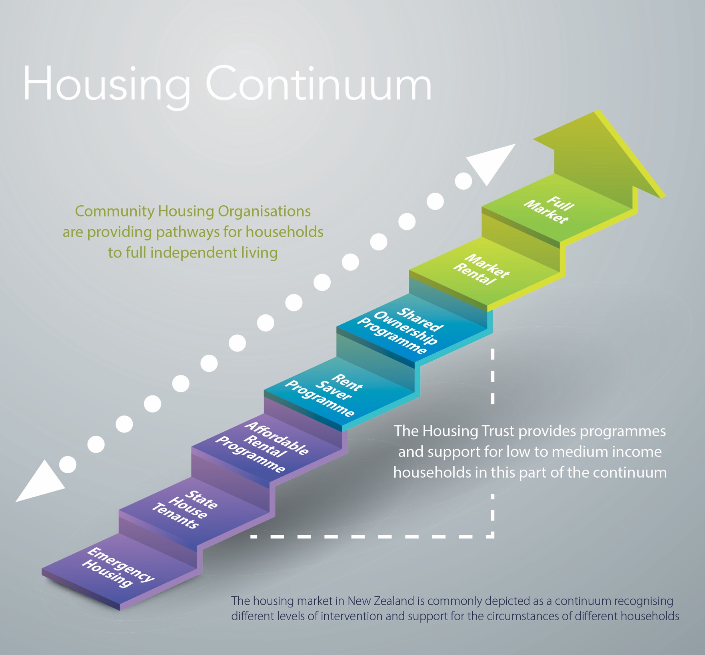

Slide 32
A Growing Sector:
Top 15 operate 10,700 homes
CHRA # | Community Housing Organisation | # Homes
RA047 | Tāmaki Housing Association | 2707
RA002 | Accessible Properties Ltd | 2504
RA050 | Ōtautahi Community Housing Trust | 2289
RA044 | The Selwyn Foundation | 650
RA011 | Habitat for Humanity New Zealand | 553
RA034 | Trust House Limited | 478
RA040 | The Salvation Army | 368
RA009 | CORT Community Housing | 239
RA019 | New Zealand Housing Foundation | 148
RA021 | Tauranga Community Housing Trust | 140
RA020 | Queenstown Lakes Community Housing Trust | 139
RA007 | Comcare Trust | 134
RA046 | Abbeyfield NZ Inc | 132
RA049 | Homes of Choice Limited | 117
RA014 | LinkPeople | 103
Notes:
Community Housing Regulatory Authority
A total of 37 CHRA registerd organisations operate 11,422 units across NZ
3 (soon to be 4) have around 2500 units;
12 operate between 100-600 and these 12 all need to grow to operate 1000+ units in order to meet local demand
Smallest 23 organisations need to grow to 500 scale
All have grown by accessing someone else’s balance sheet
For economies of scale, need to grow
Top 4 to 5000 units each = 20,000 units
mid 15 to 1000 units each = 15,000 units
Smallest 23 to 500 units each = 12,000 units
= a sector of ~50,000 units, with HNZC at 60,000 units

Slide 33
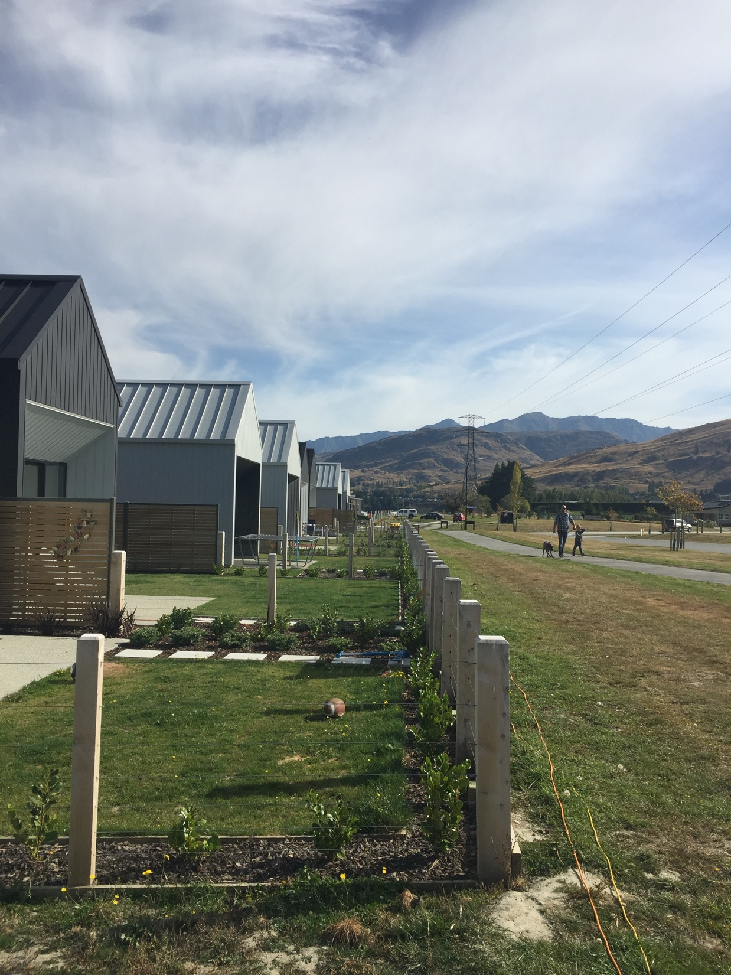
Actions in High and Medium Growth Cities

Slide 34
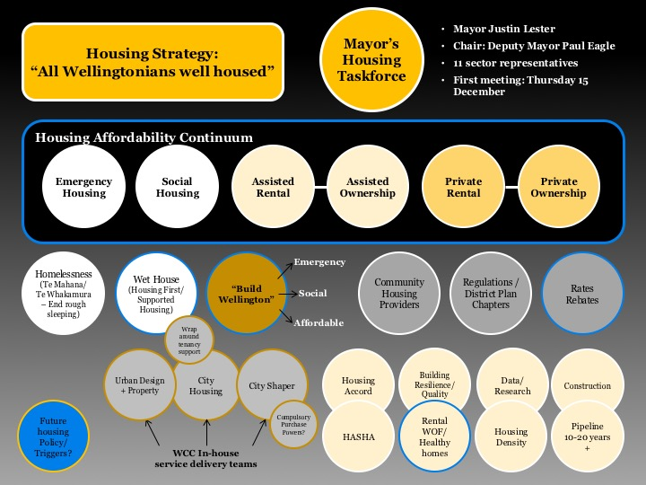
Notes:
Talk about:
Wellington
Auckland
Christchurch
Tauranga

Slide 35

October 2016: Adopted a 5-10% target for affordable rental housing for low and very low income households in all new development in new urban renewal and greenfield areas

Slide 37
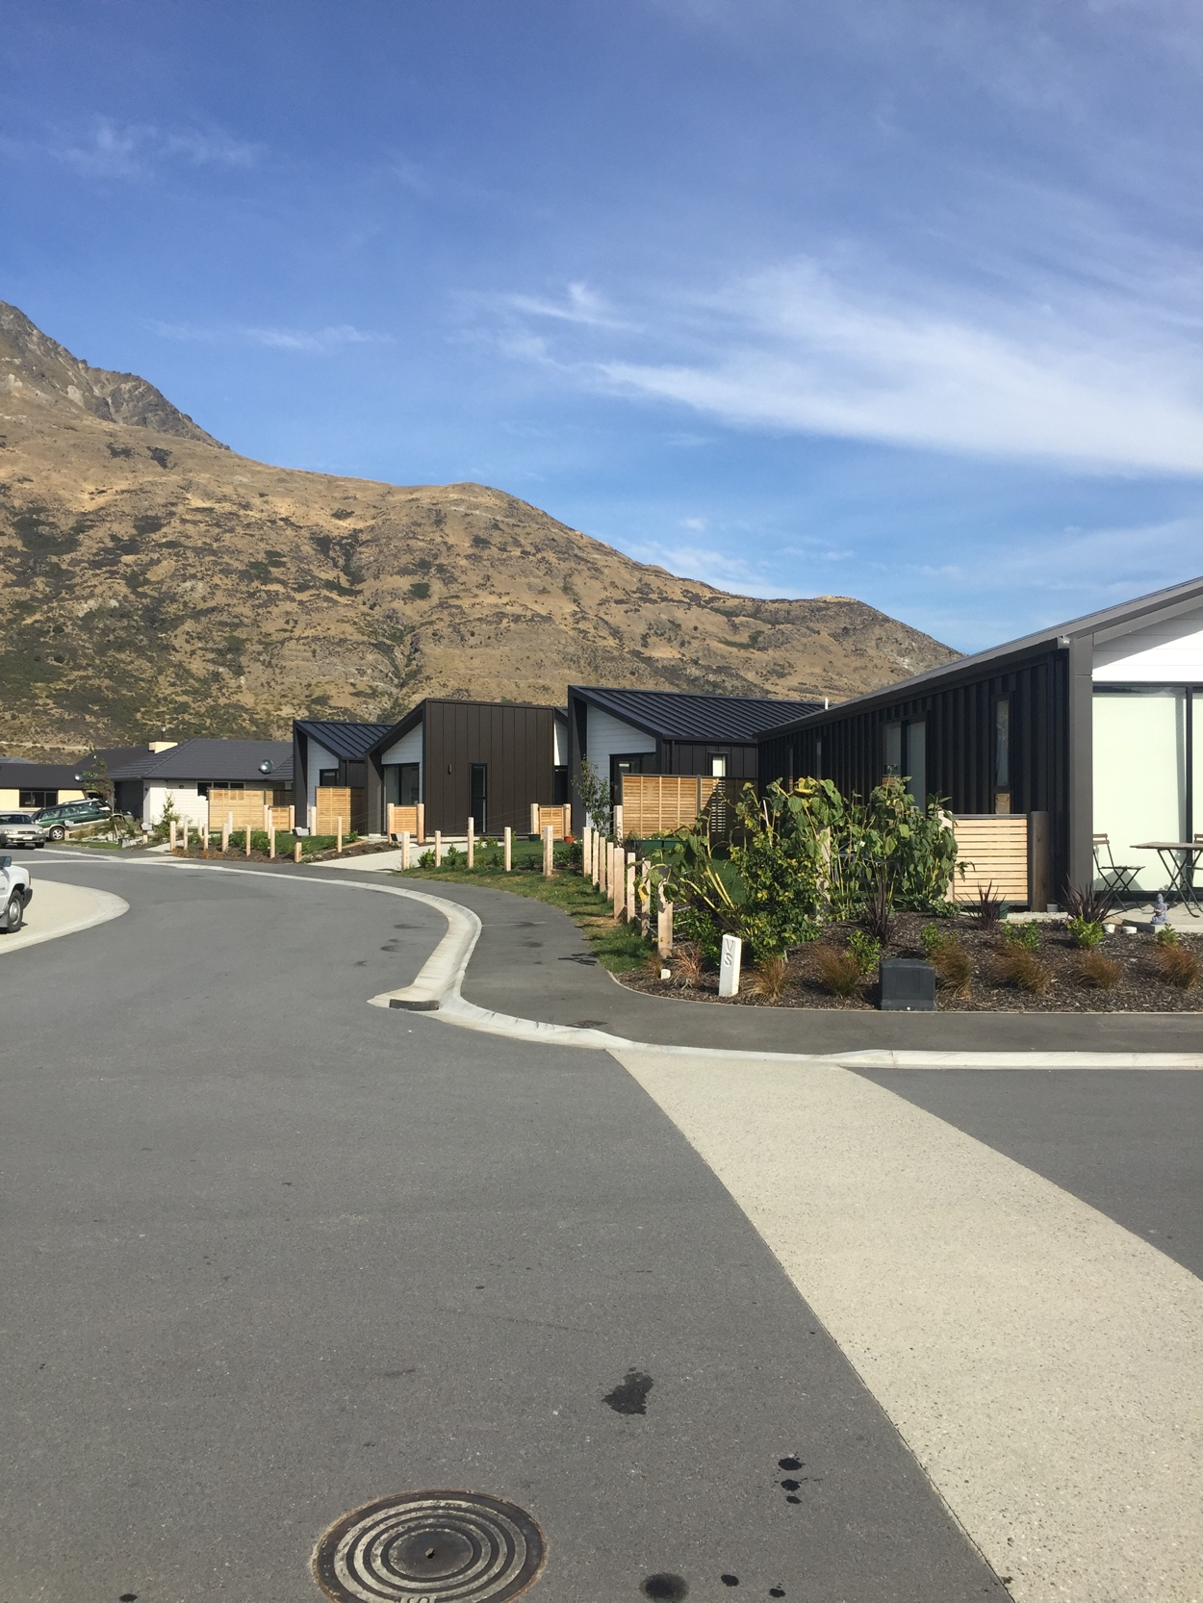
Evidence supporting solutions

Slide 38
“. . .Perhaps more importantly for the District will be the development of expertise and institutional capacity, to address housing affordability over the longer term. “
Notes:
Council and community leadership back in 2003 laid the groundwork for a plan, adopted by Council in 2005
Defined the problem, and set out 32 Actions across Policy, Planning, Financial, Delivery
Set up of QLCHT and plan change for Inclusionary Zoning were 2 actions

Slide 39
Notes:
Stakeholder Deeds – Negotiated Agreements supported as a viable way forward in the early days

Slide 42
Notes:
Where we should be at today: 3706
Where we are: ~170: add up QLCHT, HNZC, Council, Abbeyfield

Slide 43
2007: First mapping of Demand across the Continuum
Rental: 1274+209 = 1483
Shared Own: 93 + 1542 = 1635

Slide 44
“We found no significant variation in house price changes in Queenstown between houses neighbouring affordable properties and control groups. The benefits clearly outweigh any risks,”
$14.4m land value + 4.8m Crown grants. . . Now $28m community asset

Slide 45
“. . . mandatory programs in strong housing markets that have predictable rules, well-designed cost offsets, and flexible compliance alternatives tend to be the most effective types of inclusionary housing programs.”

Slide 46

Appetite to consider?
A range of interventions-
Retention options
  Council Ownership – Trust - Covenant
Investment in Affordable Housing: Revenue options
  Bed Tax
  Long term, low fixed rate interest debt
  Capitalised Accommodation Supplement
Improved benefits for households
  Accommodation Supplement update
Incentives with Retention of Affordability
  Deferred payment of GST
  Deferred payment of Development Contributions
  Density bonus
  Reduced parking
  Fast track consenting

Slide 47
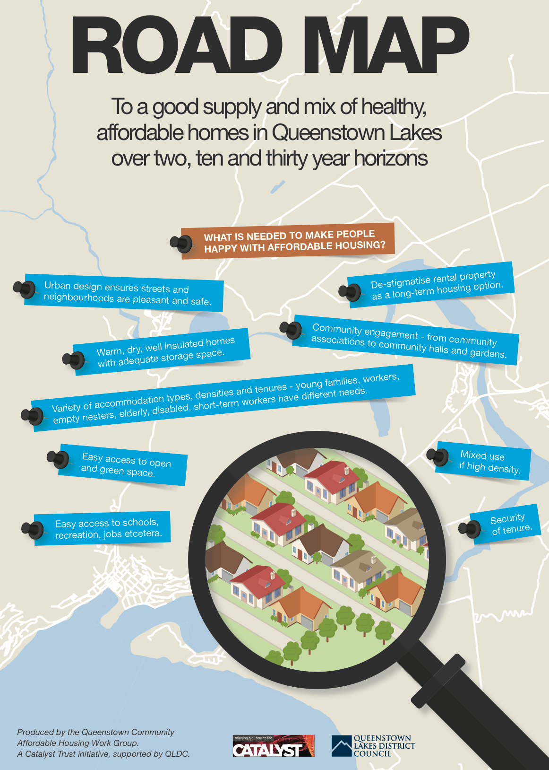
Notes:
Time for an updated strategy – thanks to Catalyst and QLDC for their 2016 report

Slide 48
The role of Queenstown Mayoral Taskforce on Housing Affordability
Councillor John MacDonald (Chair )

Slide 49
What are some options for
Queenstown Lakes?
Facilitated Discussion

Slide 50
Where to next?
Councillor John MacDonald (Chair )

