Slide 1
Arthurs Point North
            Tony Koia
On behalf of : Koia Architects Queenstown Ltd
            Koia Investments Queenstown Ltd
            Rakau Queenstown Ltd

Slide 2
Arthurs Point North – Section 42A Report
Generally Agree with many points raised in the “Section 42A Report by Emma Jane Turner”.
The report is generally supportive of commercial development to the flat area to Arthurs Point North.
We agree with the general intentions contained within the report which states the aim with regard to the flat land adjoining Arthurs Point Road to “provide for additional complementary activities that could have positive social and economic effects to the community at Arthurs Point North”.
We agree with the reports vision of allowing “people to live, work and play in the Arthurs Point Area”.
The Report also promotes the “recognition of the existing activities and character that are at Arthurs Point North”.

Slide 3
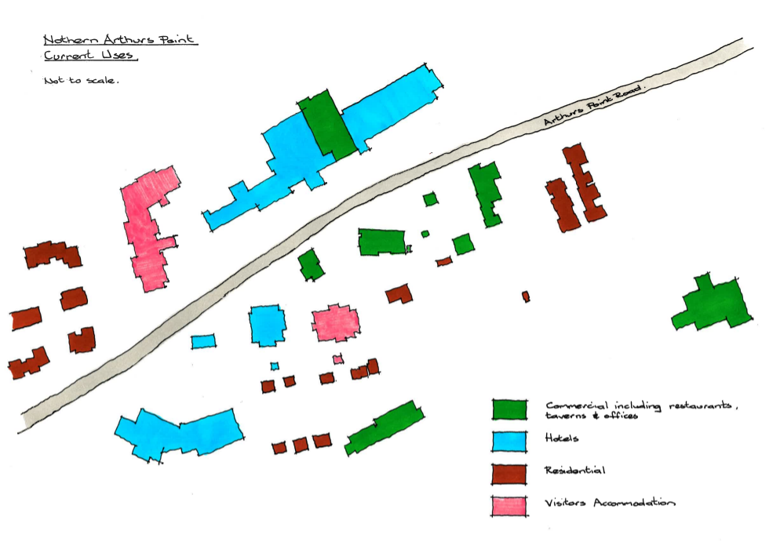
Arthurs Point North – Current Uses

Slide 4
Arthurs Point North – HDRZ Rule 9.4.11
We do however feel that some of the controls suggested and contained in the proposed HDRZ Rules are contradictory and overly restrictive regarding commercial development to the flat area of Arthurs Point North.
We feel that the HDRZ rule 9.4.11 which in effect means that non recreational commercial activities over 100sqm is a non complying activity.
We feel that this rule will inhibit commercial growth at Arthurs Point North which is at odds with the Section 42A Report which indicates that it is desirable.
We feel that commercial activity over 100sqm to the flat area of Arthurs Point North should therefore be a discretionary activity as is the case with commercial recreational.

Slide 5
Arthurs Point North – Commercial Area
We also feel that the restriction of 100sqm for permitted commercial activity is too low and restrictive because :-
A standard small café/eatery would require approx. 50sqm for back of house facilities such commercial kitchen, storage, circulation and toilets (including accessible w.c.). This would only leave 50sqm for dining/customer space which is only the space of a residential living room.
We feel that a 200sqm restriction would be more appropriate in this case with number of buildings being at the council’s discretion.
This 100sqm allocation is per Lot or Section. This is too restrictive for larger Lots where commercial activities are appropriate like the flat area to Arthurs Point North. A larger Lot could be developed with smaller individual buildings, smaller articulated forms and separate small tenancies and businesses complying with the intentions outlined in the Section 42A Report. This proposal would however be seen as a non complying activity which can’t be seen as fair or in the best interests of Arthurs Point or the Queenstown area.

Slide 6
Arthurs Point North - Example
An example of this is at 170 Arthurs Point Road located in the flat Area to Arthurs Point North. This proposal was granted resource consent in in 2017 under the Rural Visitor Zone Rules.
The site is incomplete but any further commercial development would be a non complying activity as it has already reached its 100sqm commercial allowance under the proposed HDRZ Rules.
We feel a more refined rule referring to individual building size, character and size of individual tenancies or businesses would be more appropriate.
We also feel that making commercial activities over 100sqm a discretionary activity would allow sufficient control on these items without inhibiting the natural progression of the area.

Slide 7
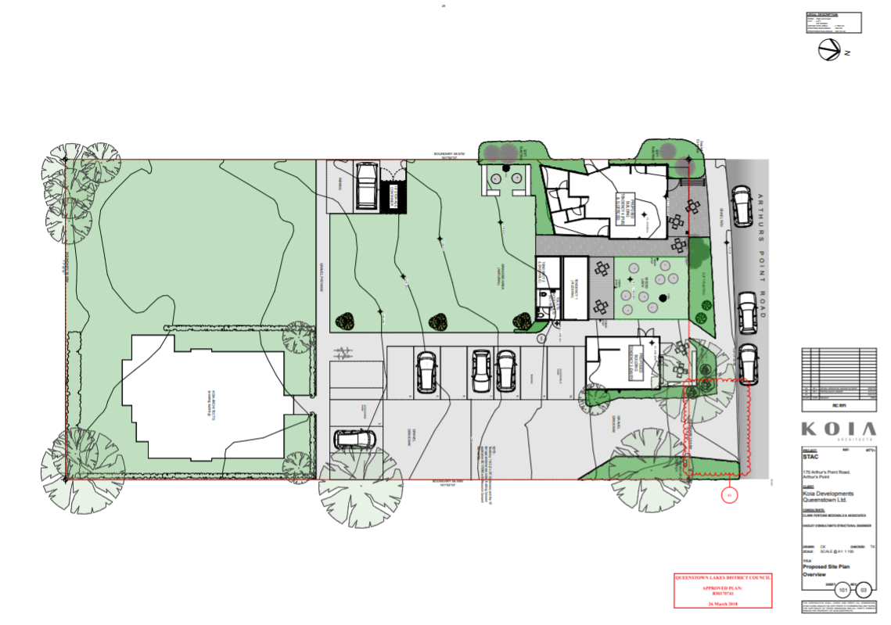
170 Arthurs Point Road – Site Plan

Slide 8
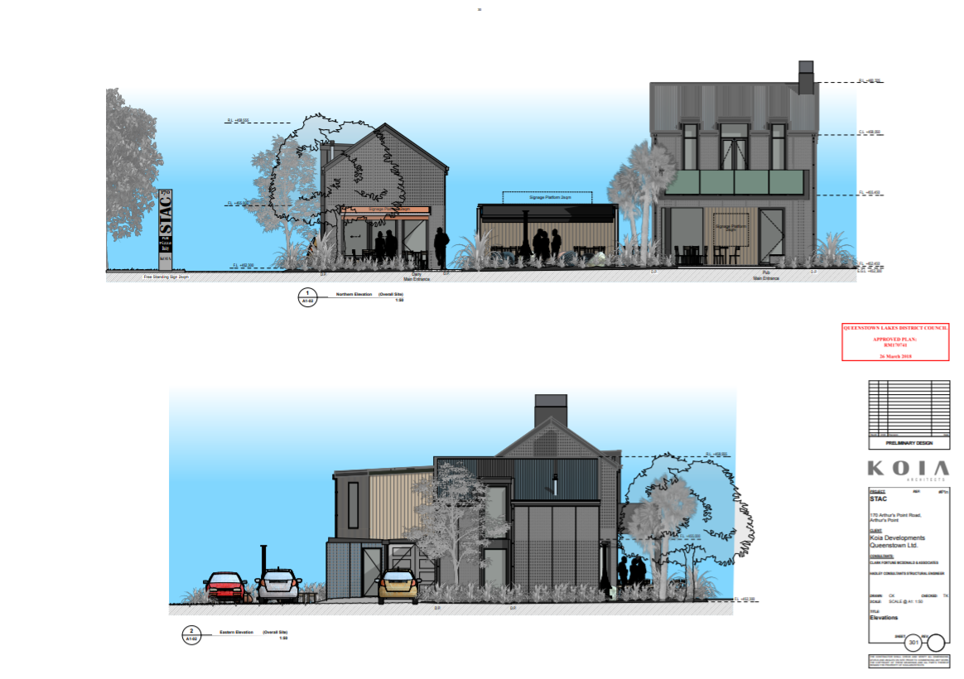
170 Arthurs Point Road - Elevations

Slide 9
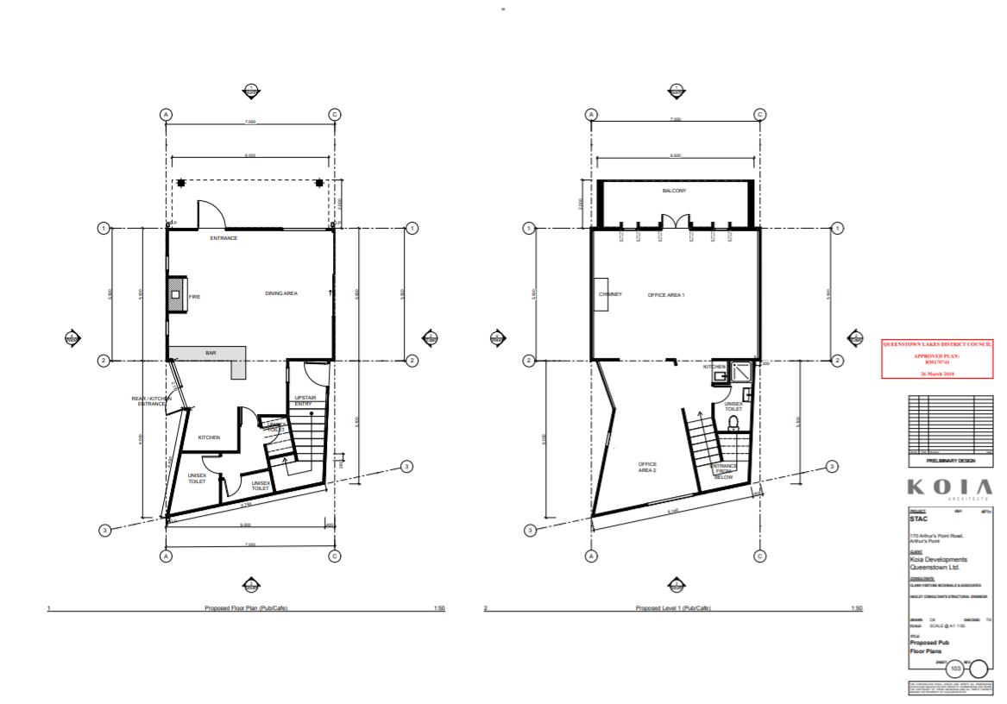
170 Arthurs Point Road – Bar Plan

Slide 10
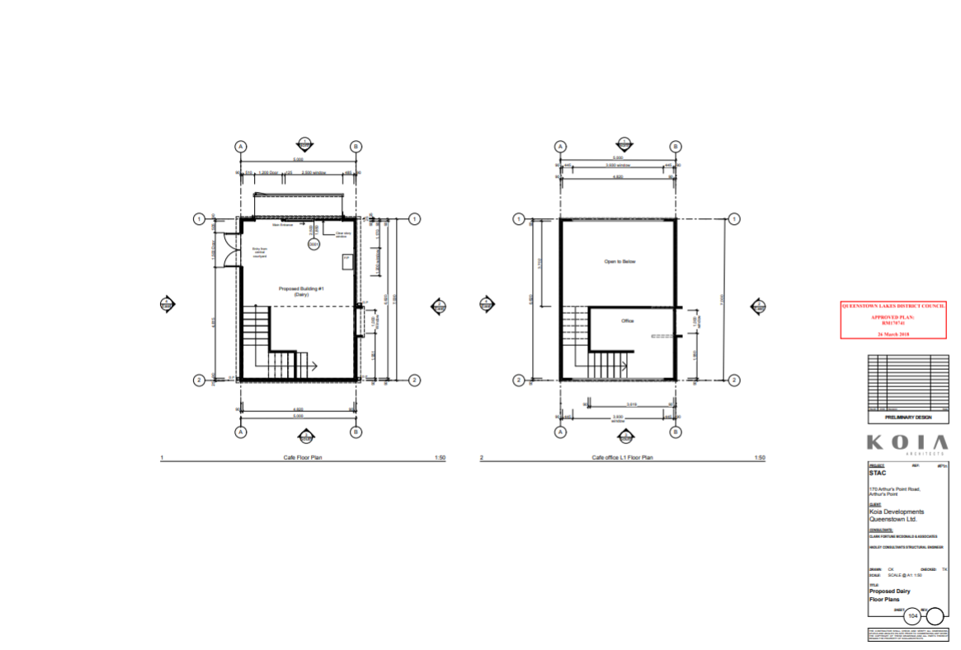
170 Arthurs Point Road – Dairy Plan

Slide 11
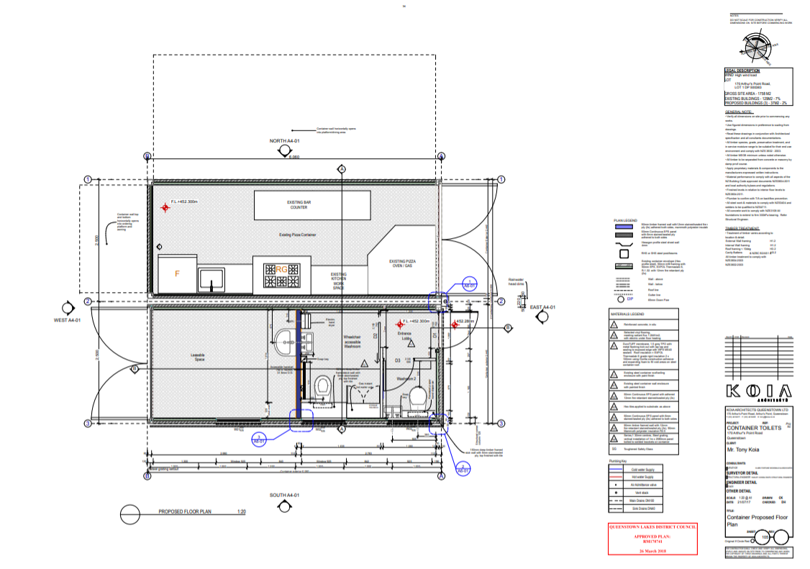
Arthurs Point Road – Rakau Plan (Existing)

Slide 12
Arthurs Point North
Emma Jane Turner in her rebuttal dated 12th June 2020 mentions that the effect of an increase of the gross floor area restriction would undermine the viability and role of other commercial centres.
We feel that the likely scale of commercial activity would be low compared to commercial centres such as Arrowtown, Glenda Drive, Frankton/five mile and Industrial Place/Gorge Road. These centres are also relatively approx. 13km away apart from Industrial Place/Gorge Road which has a more trade orientated commercial character.
We therefore feel that the effect of any increase in the GFA restriction would be virtually insignificant on other commercial centres given their comparatively large scale.

Slide 13
Arthurs Point – National Policy Statement on Urban Development 2020
Comes into force on 20th of August 2020.
To provide well functioning urban environments to enable all people and communities to provide for their social, economic and cultural wellbeing.
To provide adequate opportunities for land to be developed to meet community, business and housing needs.
Ensuring “that rules are not unnecessarily constraining growth”.
We support the broad objectives of the Section 42A Report but feel that the controls mentioned do not support these objectives.

Slide 14
Arthurs Point Road – Recession Plane
We proposed an alternative to the proposed HDRZ recession plane rules of 2.5m above ground at an angle of 45 degrees (55 degrees to northern boundary) on the basis that this combined with the 2m setbacks will result in buildings being located close to the boundary with the upper levels being stepped back to be within the recessing plane resulting in a unflattering aesthetic more suited to more densely populated city centres.
Our proposal was for a sliding scale where buildings set back 3m from boundaries would have a 3 storey (9m) max. height and buildings set back 4m would have a 4 storey (12m) max. height.
We feel that this would allow more space for landscaping and may reflect the buildings effect in its surroundings more accurately.
Emma Jane Turner in her Rebuttal said that ”I consider there may be benefits in using a sliding scale as outlined in their evidence”. She then went on to discount a change to this rule on grounds of inconsistency and complication.
We feel if a change can result in better outcomes they should be carefully considered in the interests of improvement and innovation.

Slide 15
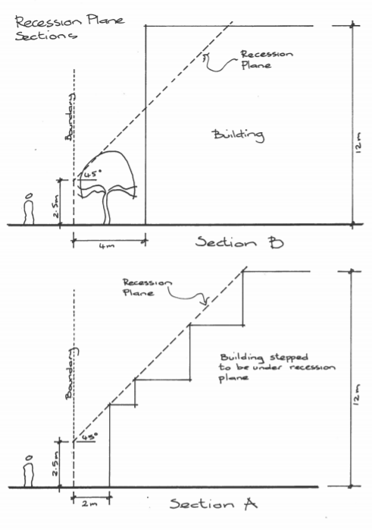
Recession Plane

Slide 16
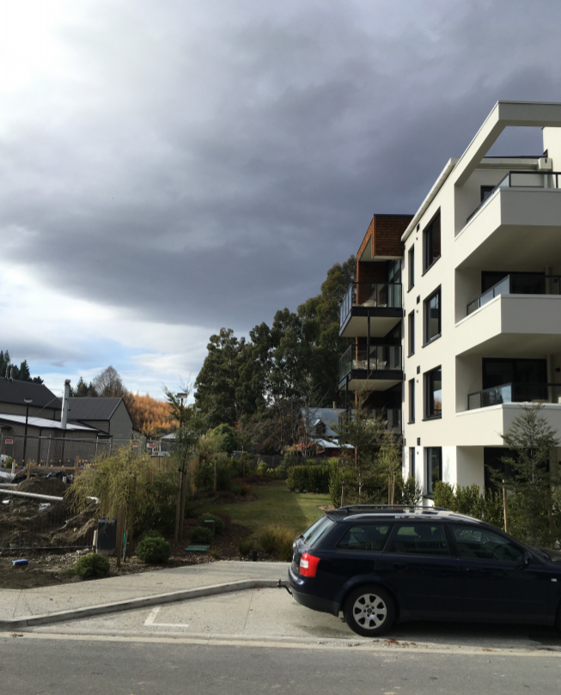
Residence Du Parc – Arthurs Point

